Slide 1
Maths Skills in Science GCSE (ITTECF 3, 4, 6) ‘Schools should tackle in-school inconsistency of teaching, making more good or outstanding, so that every pupil receives a good mathematics education’ (OFSTED 2022)

Slide 2
Session Leader:- Pietro Tozzi
40 years’ experience of teaching/training in London comprehensive schools
Head of Department Experience
Mentored over 150 ITT trainees and ECTs
Senior Lecturer & Course Lead (PGCE Maths) at St Mary’s University, Twickenham
Acted as a case study for an awarding body
Assisted in the writing of the GCSE 2010 Modular, Linked Pair Pilot & A-Level (2017) Schemes of Work
Nominated for a National Teaching Award
Notes:
Pietro Tozzi Bio

Slide 3
Maths Skills in Science
What the examiners said…

Slide 4
Maths Questions
Overall:
Questions with a mathematical component were generally answered well.
Maths rarely resulted in candidates failing to successfully answer a question
When given an equation, candidates generally scored highly on calculations
Where candidates ‘lost’ marks:
Standard form - often well answered, but this is where marks if any were dropped
Significant figures
Rounding
Units
Conversions

Slide 5
Maths Skills in Science
Generally Maths skills were applied well
Some specific challenges included:
Calculating concentration
Mass - mass calculations using balanced equations
Empirical formula
Calculating kinetic energy
SI units e.g. Mass, kg, g and N and how to handle these in calculations
Examiner report comment
“Always show mathematical workings when doing a calculation, as (method) marks will be awarded for errors carried forward”

Slide 6
Maths skills in Science
Key challenges for students include:
Changing the subject of an equation
Significant figures
Standard form
Reading, describing and interpreting graphs
Physics Acceleration due to gravity 9.81 ms⁻²
and for Mechanics A Level g = 9.8 ms⁻²
Any other areas of weakness?

Slide 7
Maths skills in Science
Significant figures
Examiner report comments indicate students did not always attempt to give an answer to the number of significant figures asked for OR they rounded incorrectly.
It is useful to highlight the advantages of significant figures over decimal places by showing that the accuracy does not change when changing units, with significant figures.
i.e. 4.2 mm is 0.42 cm is 0.0042 m all to 2 s.f. but,
0.42 cm is 0.00 m to 2 d.p. (!)

Slide 8
Maths skills in Science
Standard Form
Examiner report comments indicate that students either missed the instruction to give the answer in standard form OR they did not know how to show their answer in this way.
Which of the following numbers are written in standard form?
16 × 10³ N is not in standard form
0.16 × 10⁵ N is not in standard form
1.6 × 10⁴ N is in standard form

Slide 9
Maths skills in Science
Standard Form
Which of the following numbers are written in standard form?
16 × 10³ N is not in standard form
0.16 × 10⁵ N is not in standard form
1.6 × 10⁴ N is in standard form
Writing large numbers in standard form e.g. 16 000 N
Write the number as a number between 1 and 10 multiplied by a power of 10
= 1.6 x 10 000 N
Write the power of 10 using indices
= 1.6 x 10⁴ N

Slide 10
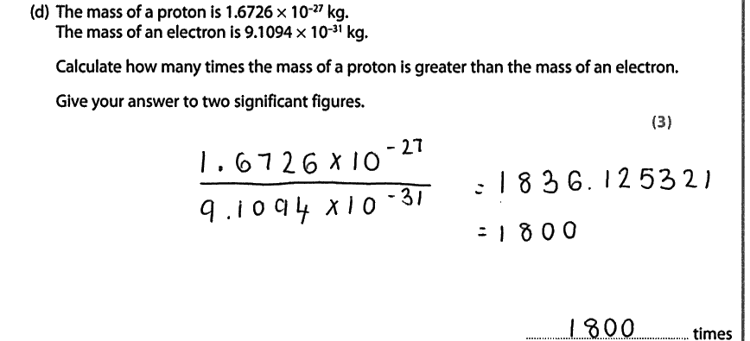
Activity
Question from Physics foundation paper involving standard form
and significant figures.
Discuss how you would teach students to
access this question.

Slide 11
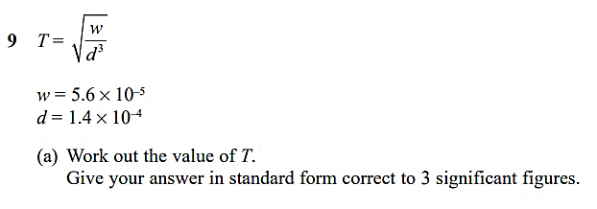
Guess the Success Rate?
37%

Slide 12
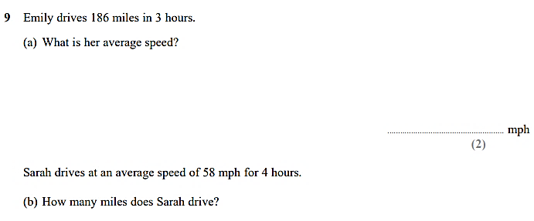
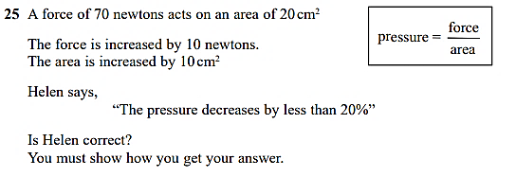
Guess the Success Rate?
86%
Foundation
32%

Slide 13
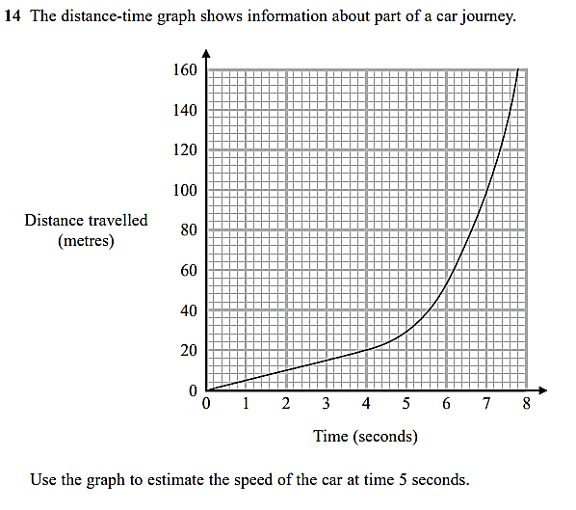
Guess the Success Rate?
21%

Slide 14
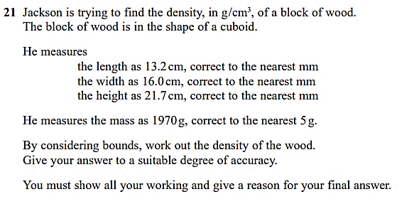
Guess the Success Rate?
28%

Slide 15
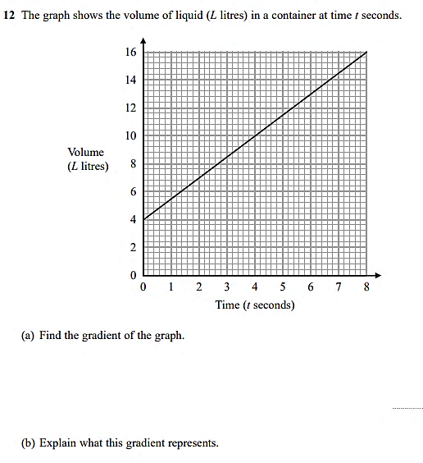
Guess the Success Rate?
56%

Slide 16
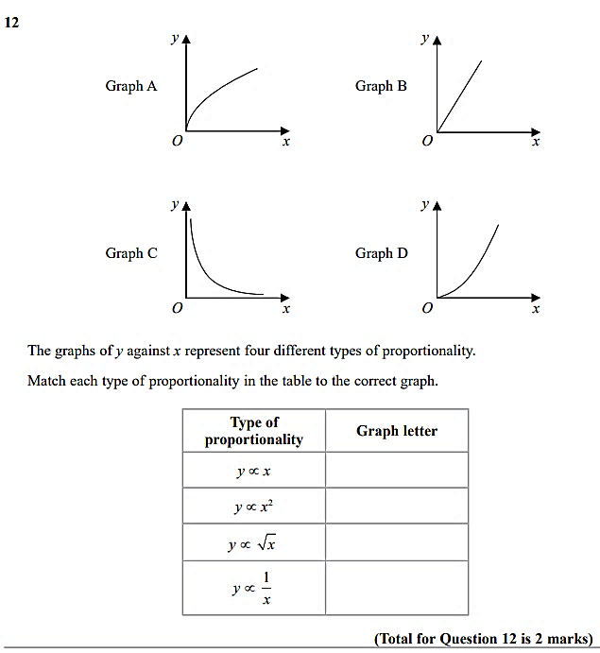
Guess the Success Rate?
56%

Slide 17
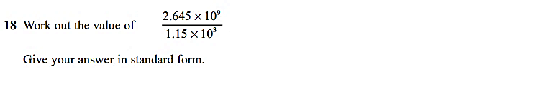
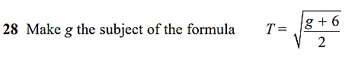
Guess the Success Rate?
Foundation
52%
Foundation
4%

Slide 18
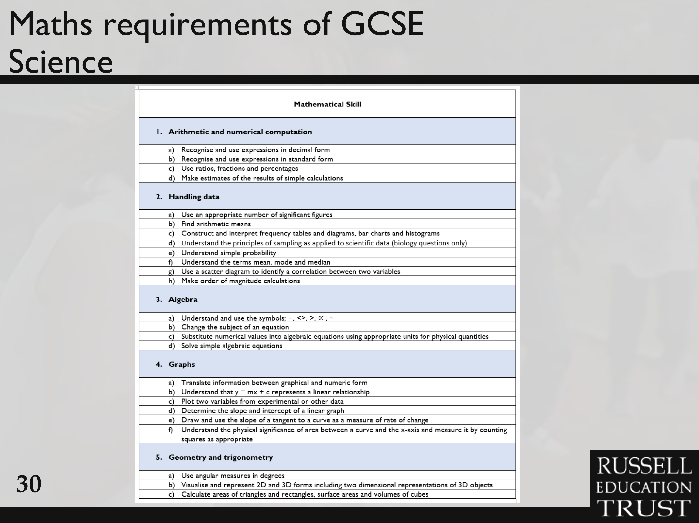



Slide 19
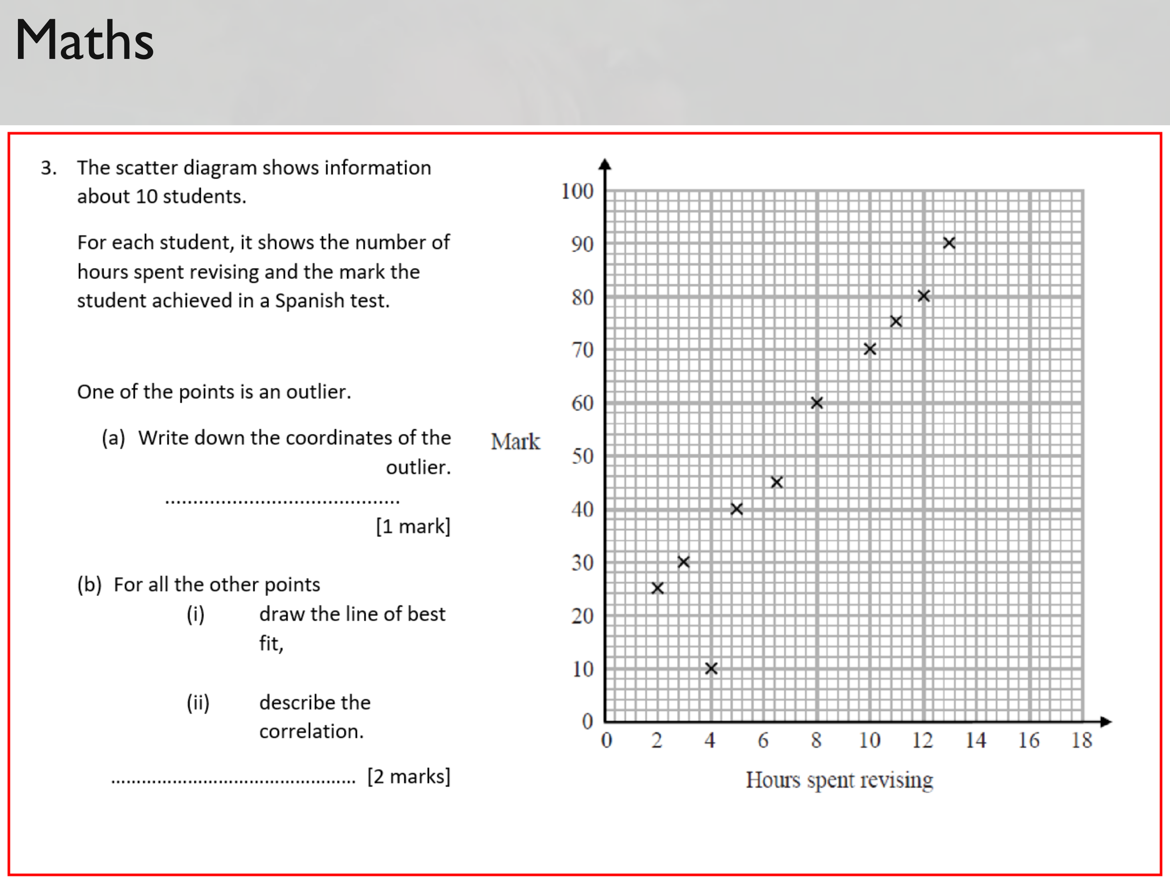

Slide 20
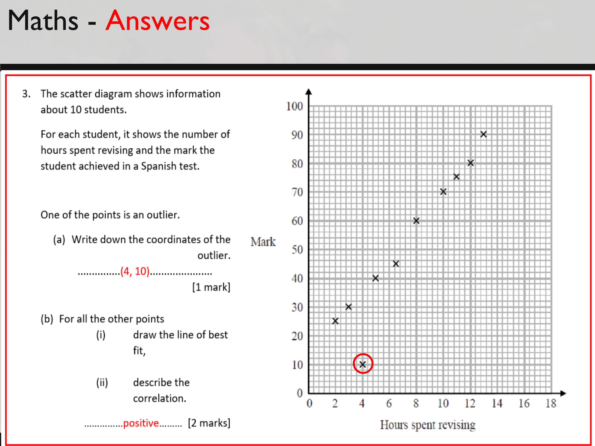

Slide 21
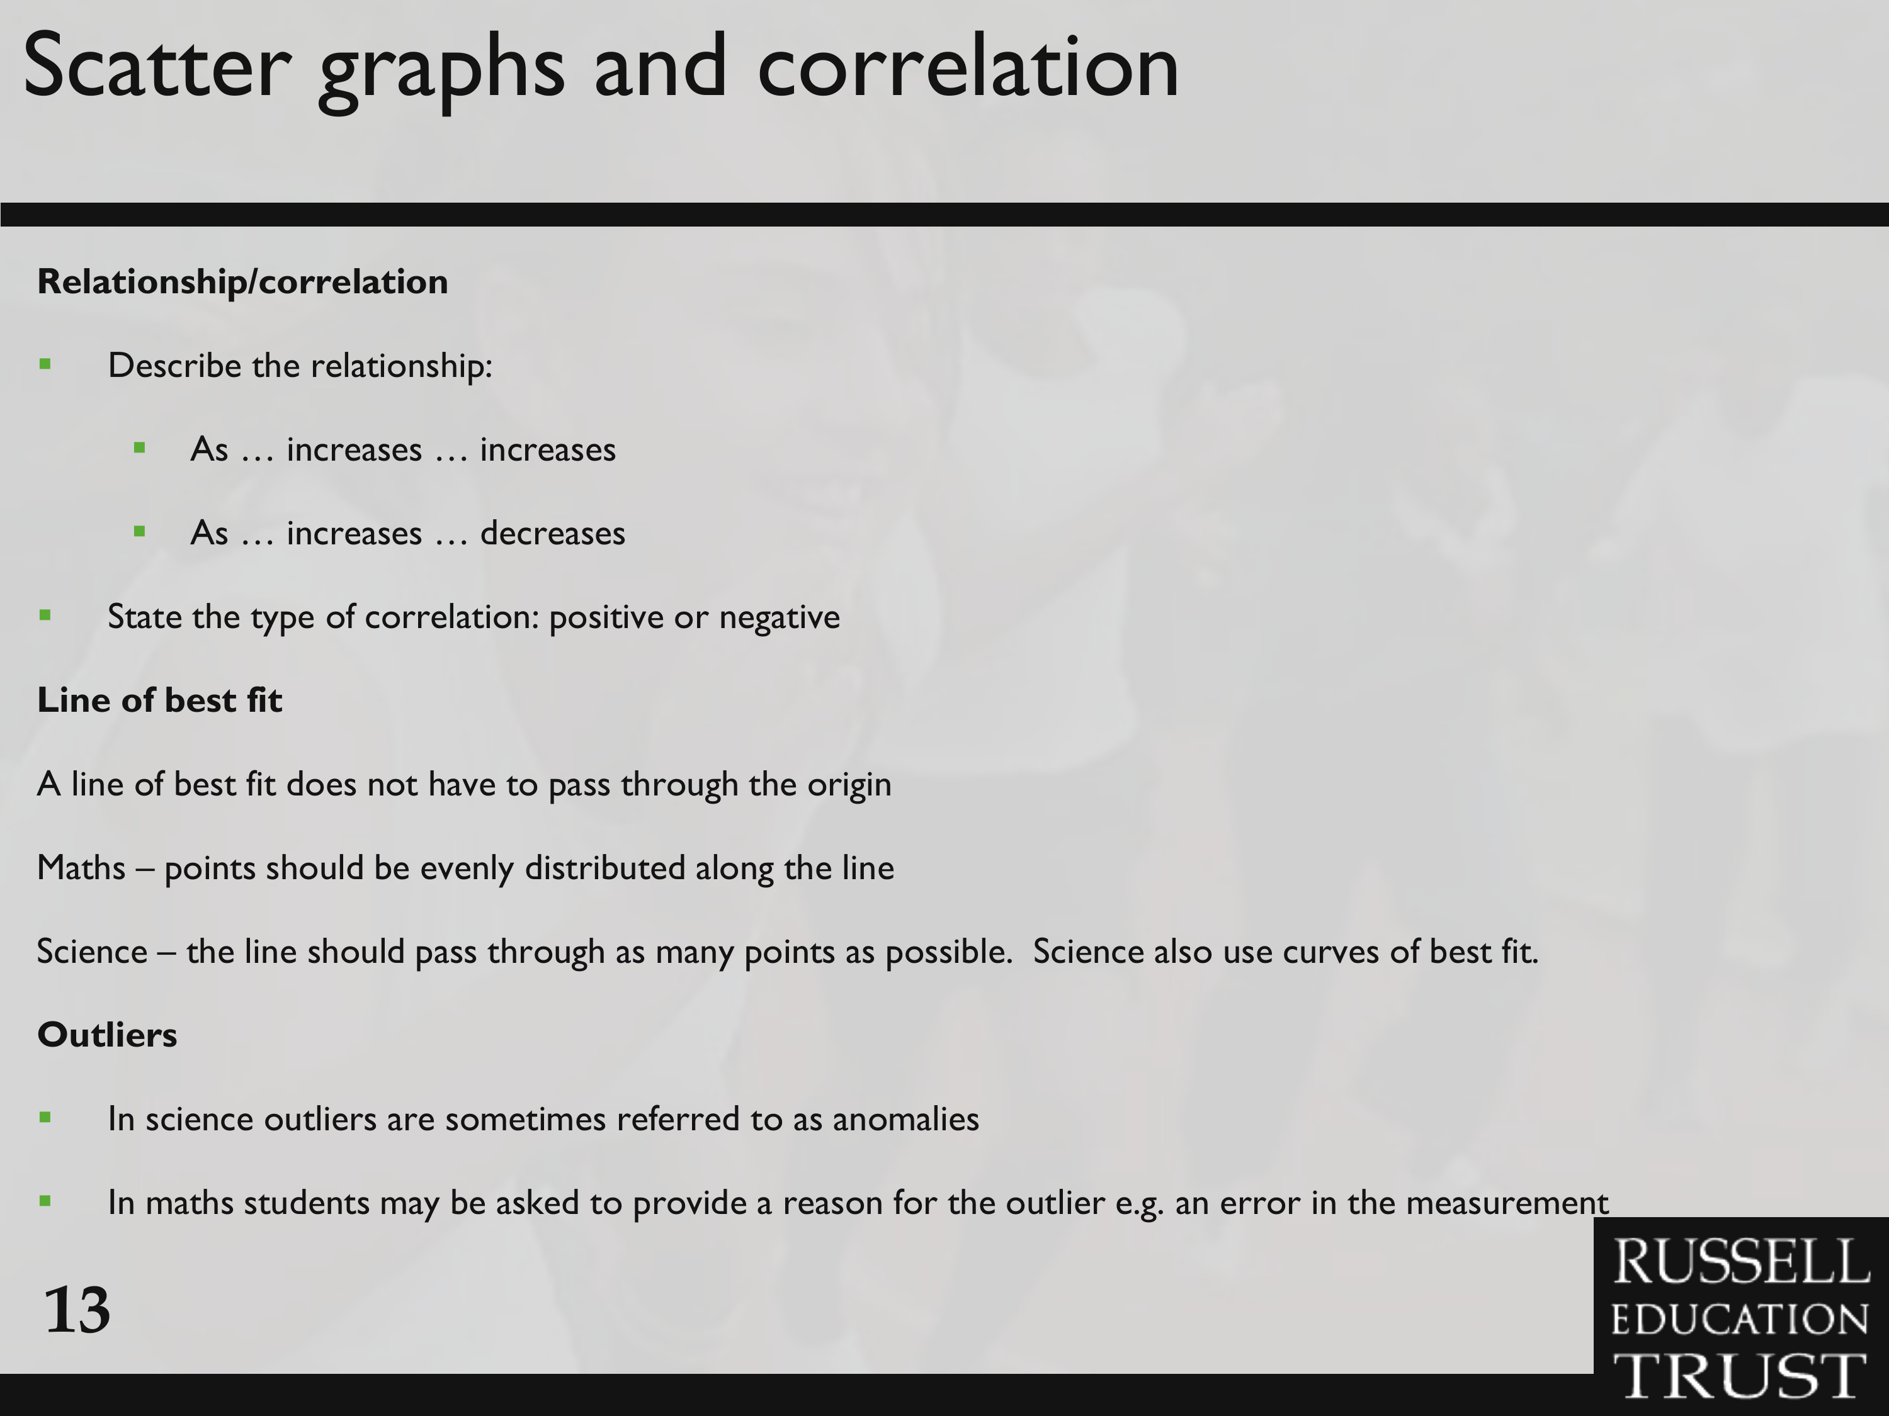

Slide 22
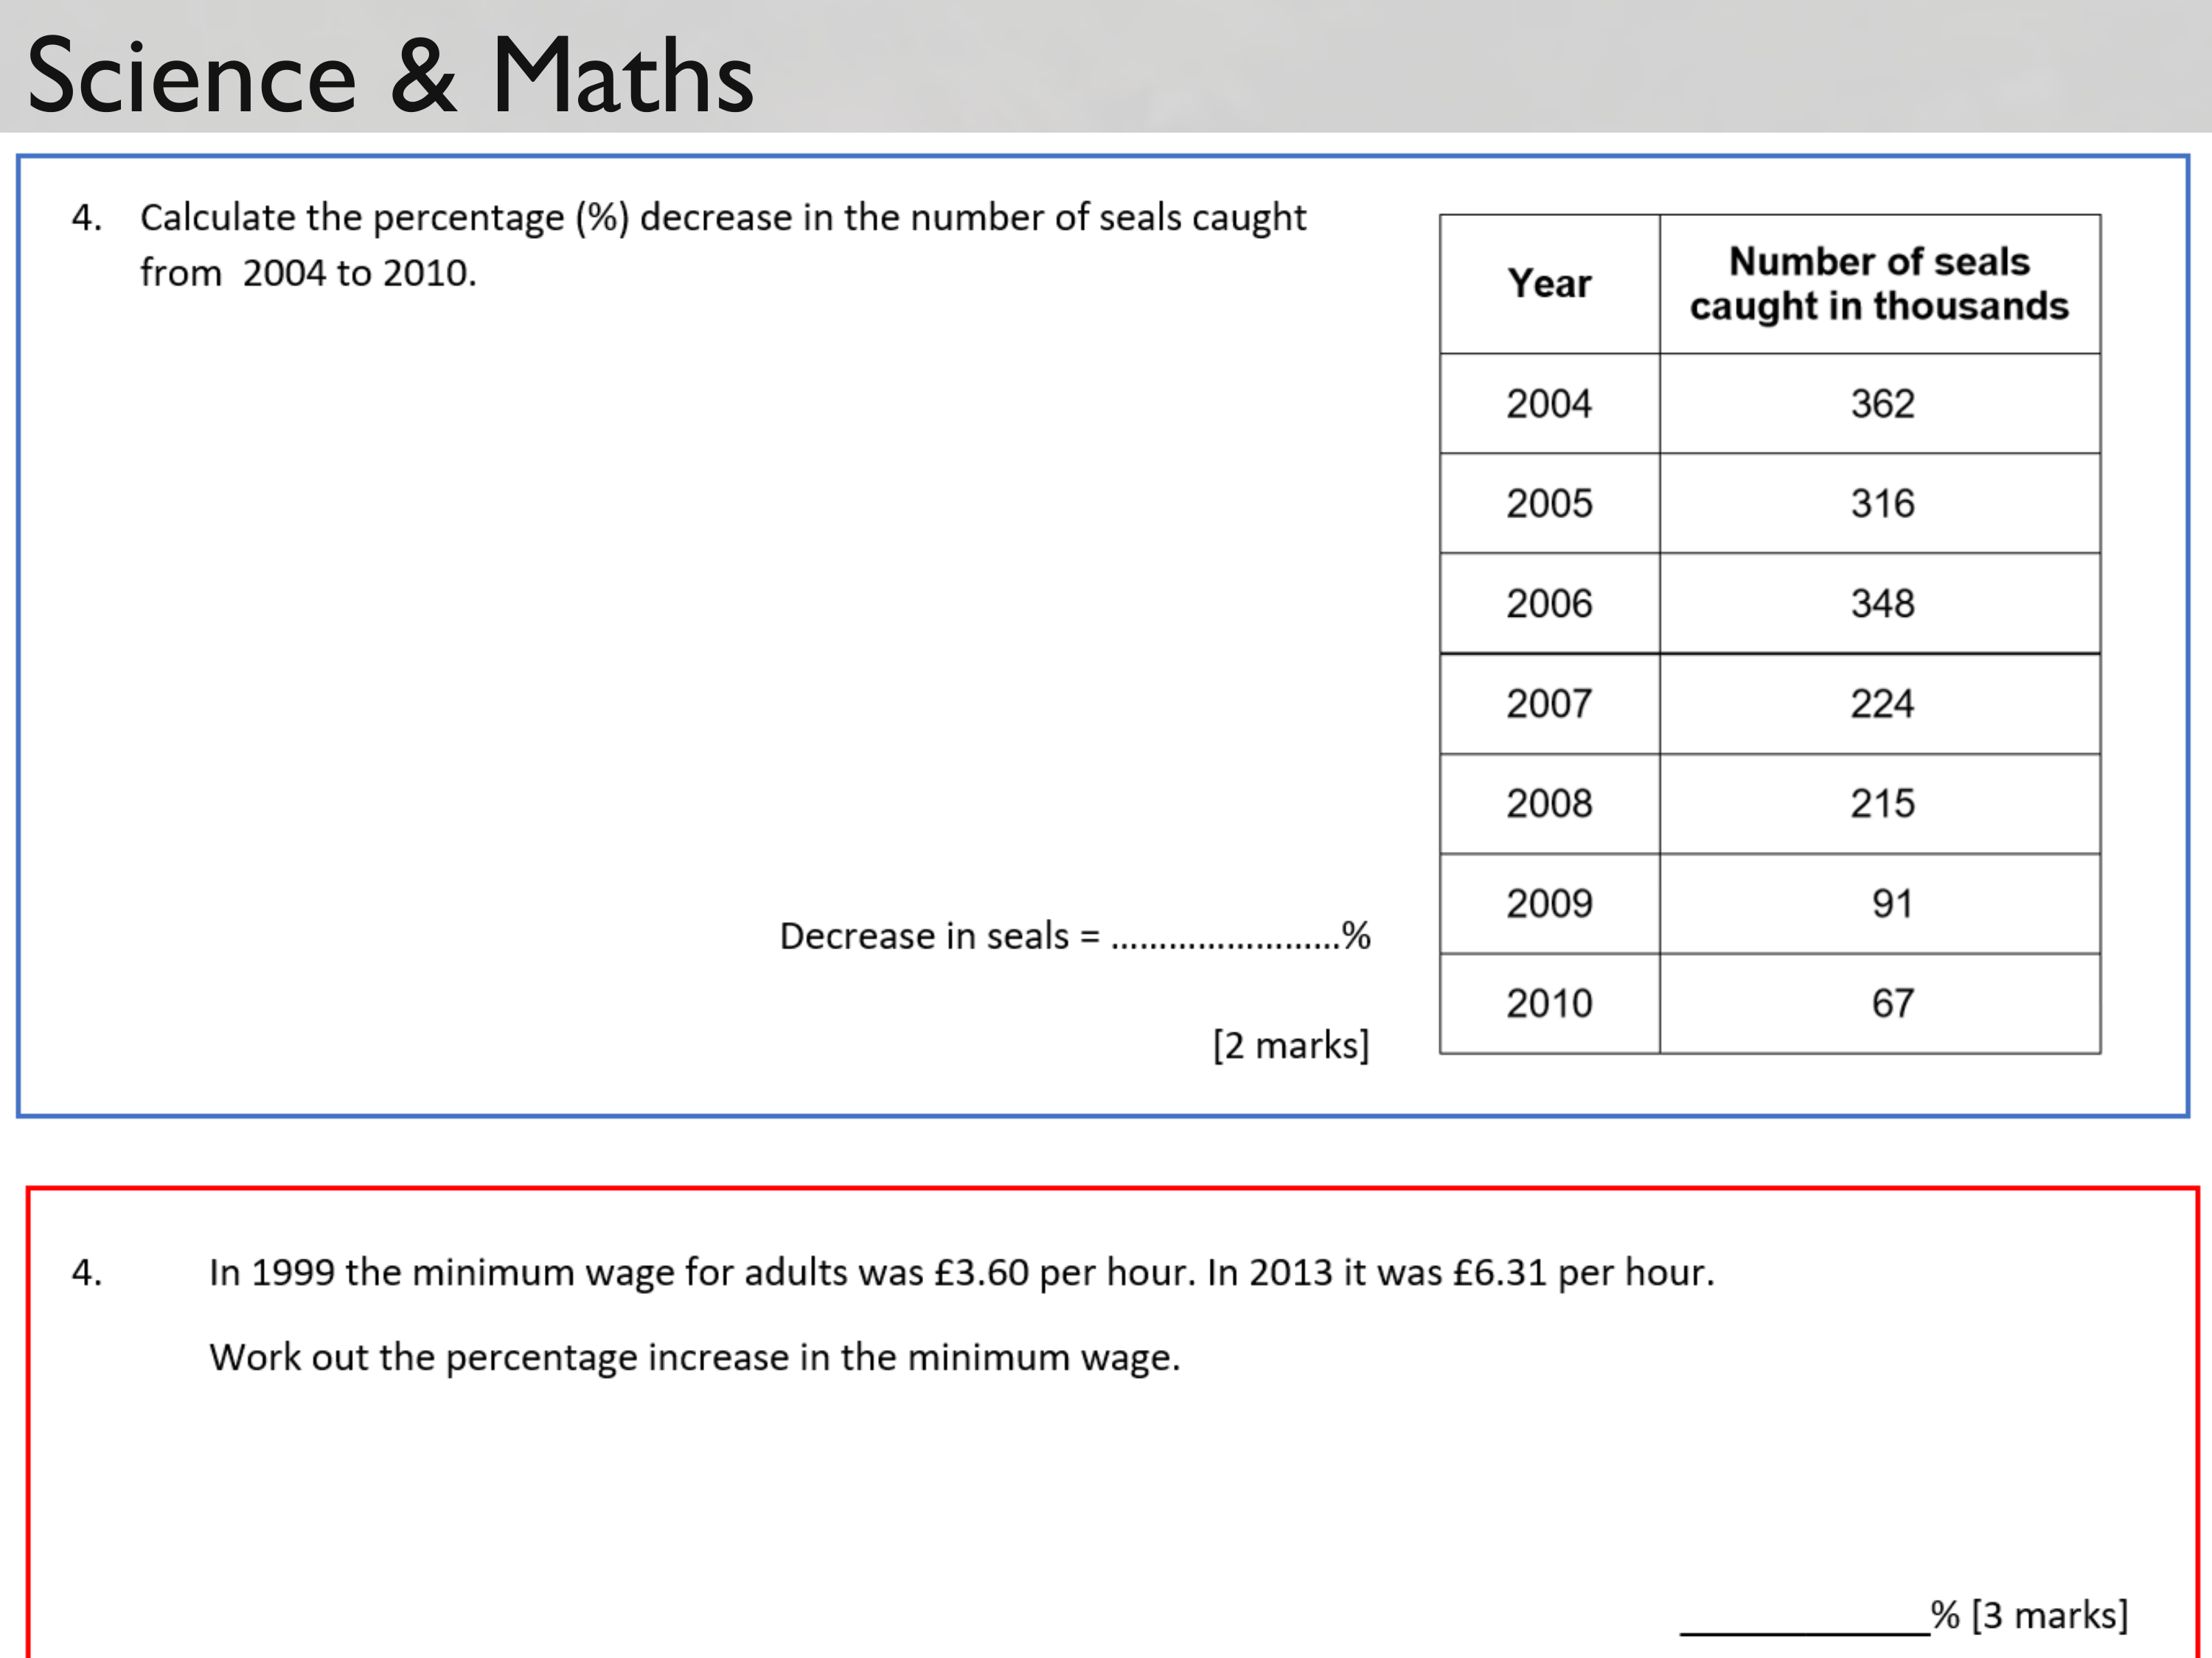

Slide 23
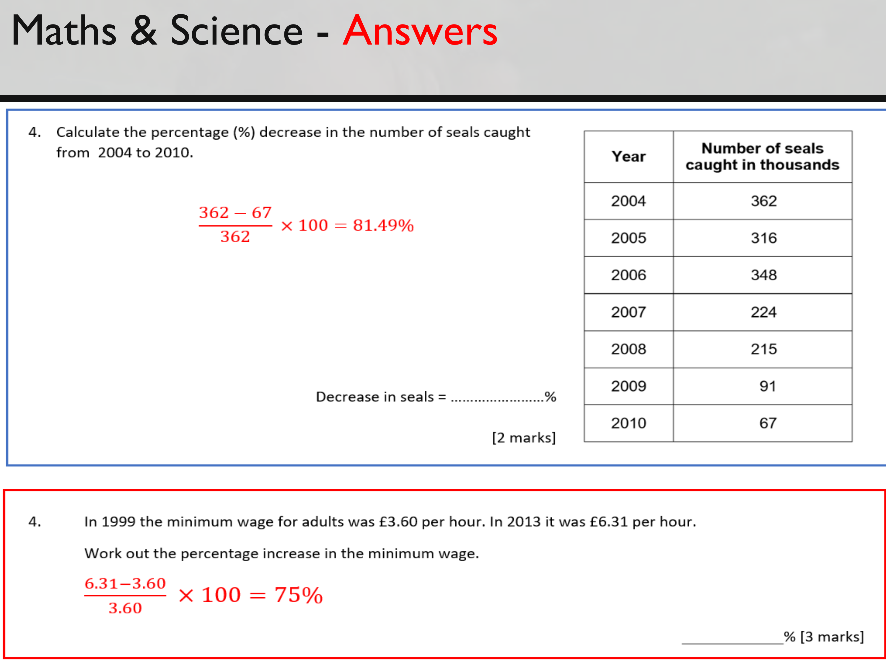

Slide 24
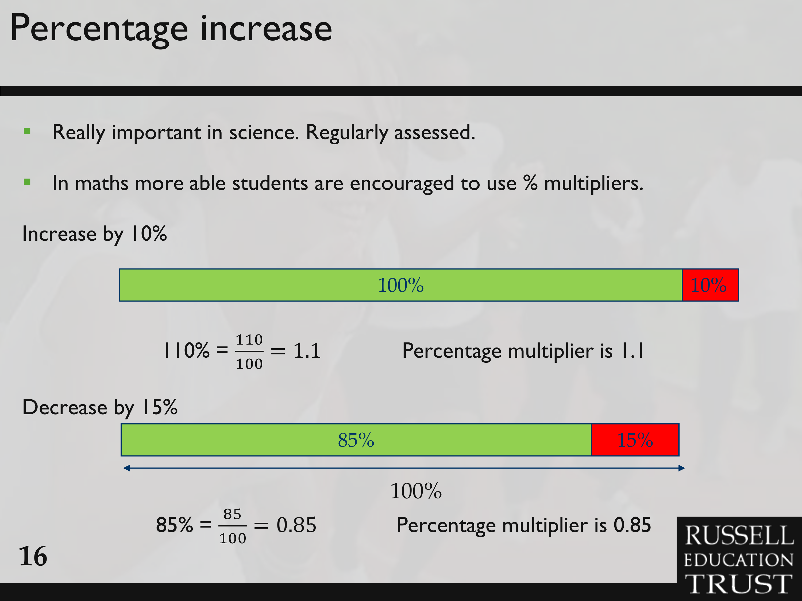

Slide 25
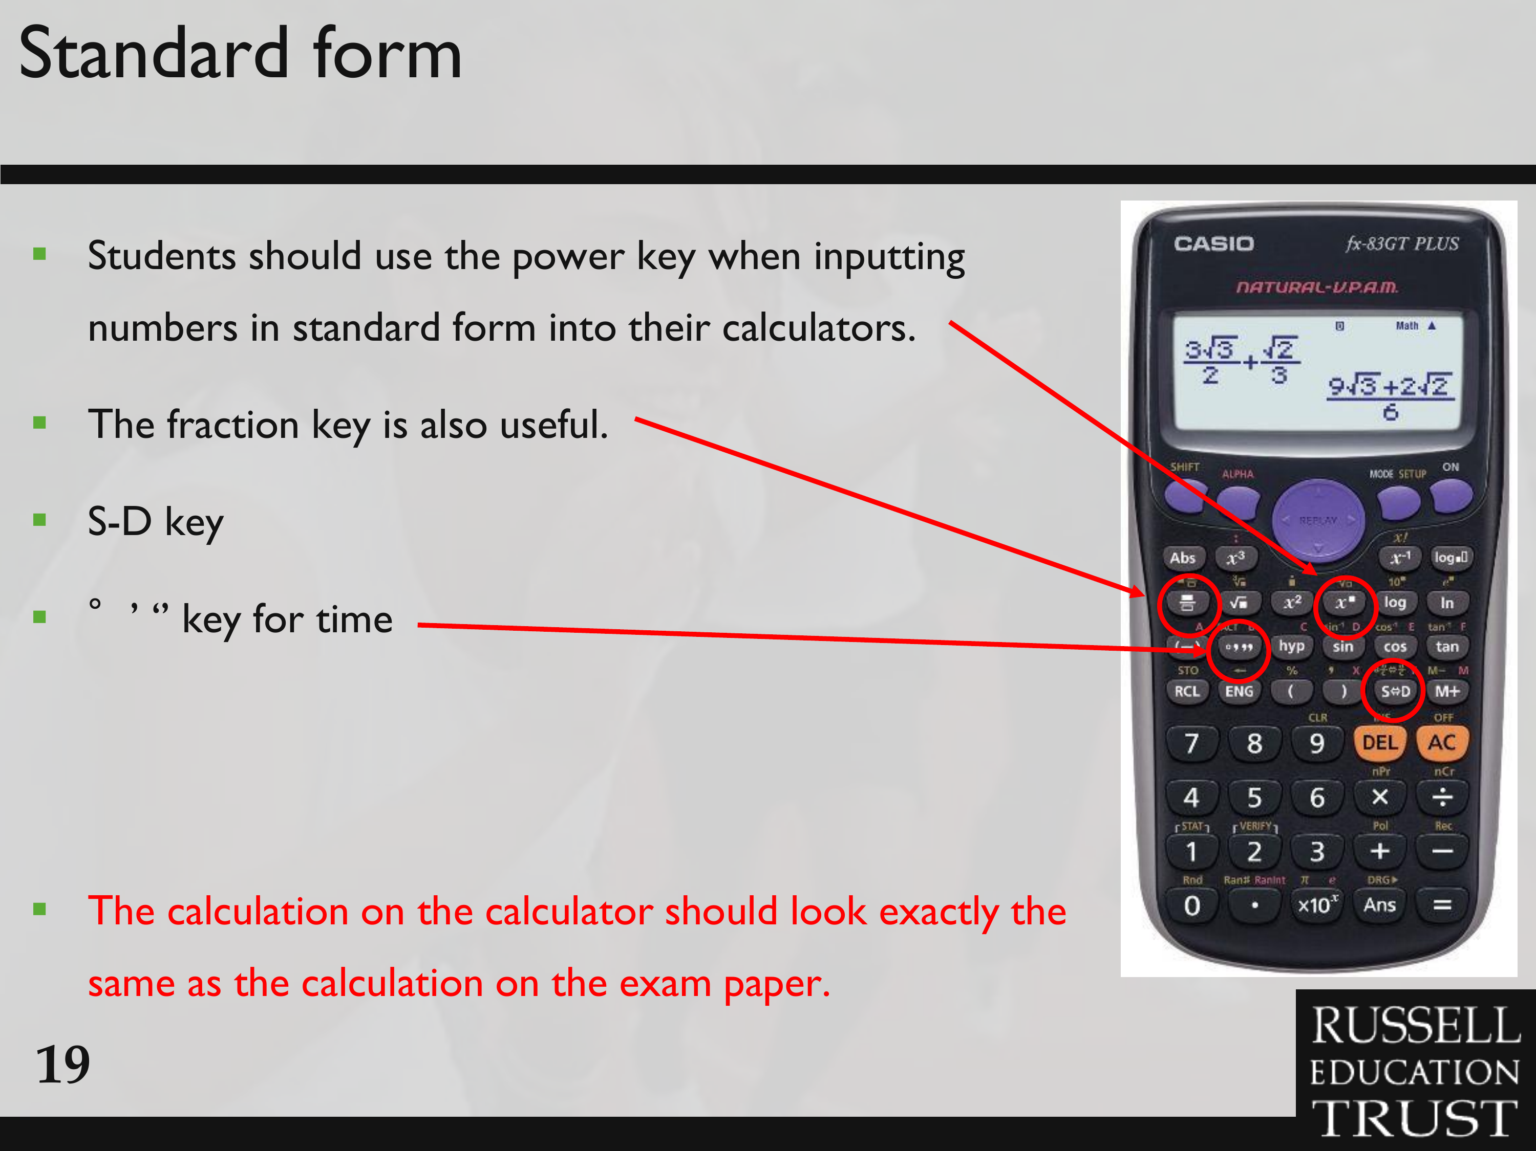
Click here for a ‘Time’ Video
Click here for a ‘Standard Form’ Video
Notes:
https://www.youtube.com/watch?v=jAinz-y6rUs (St Form)
https://www.youtube.com/watch?v=rDX93WuCCUw (Time Button)

Slide 26
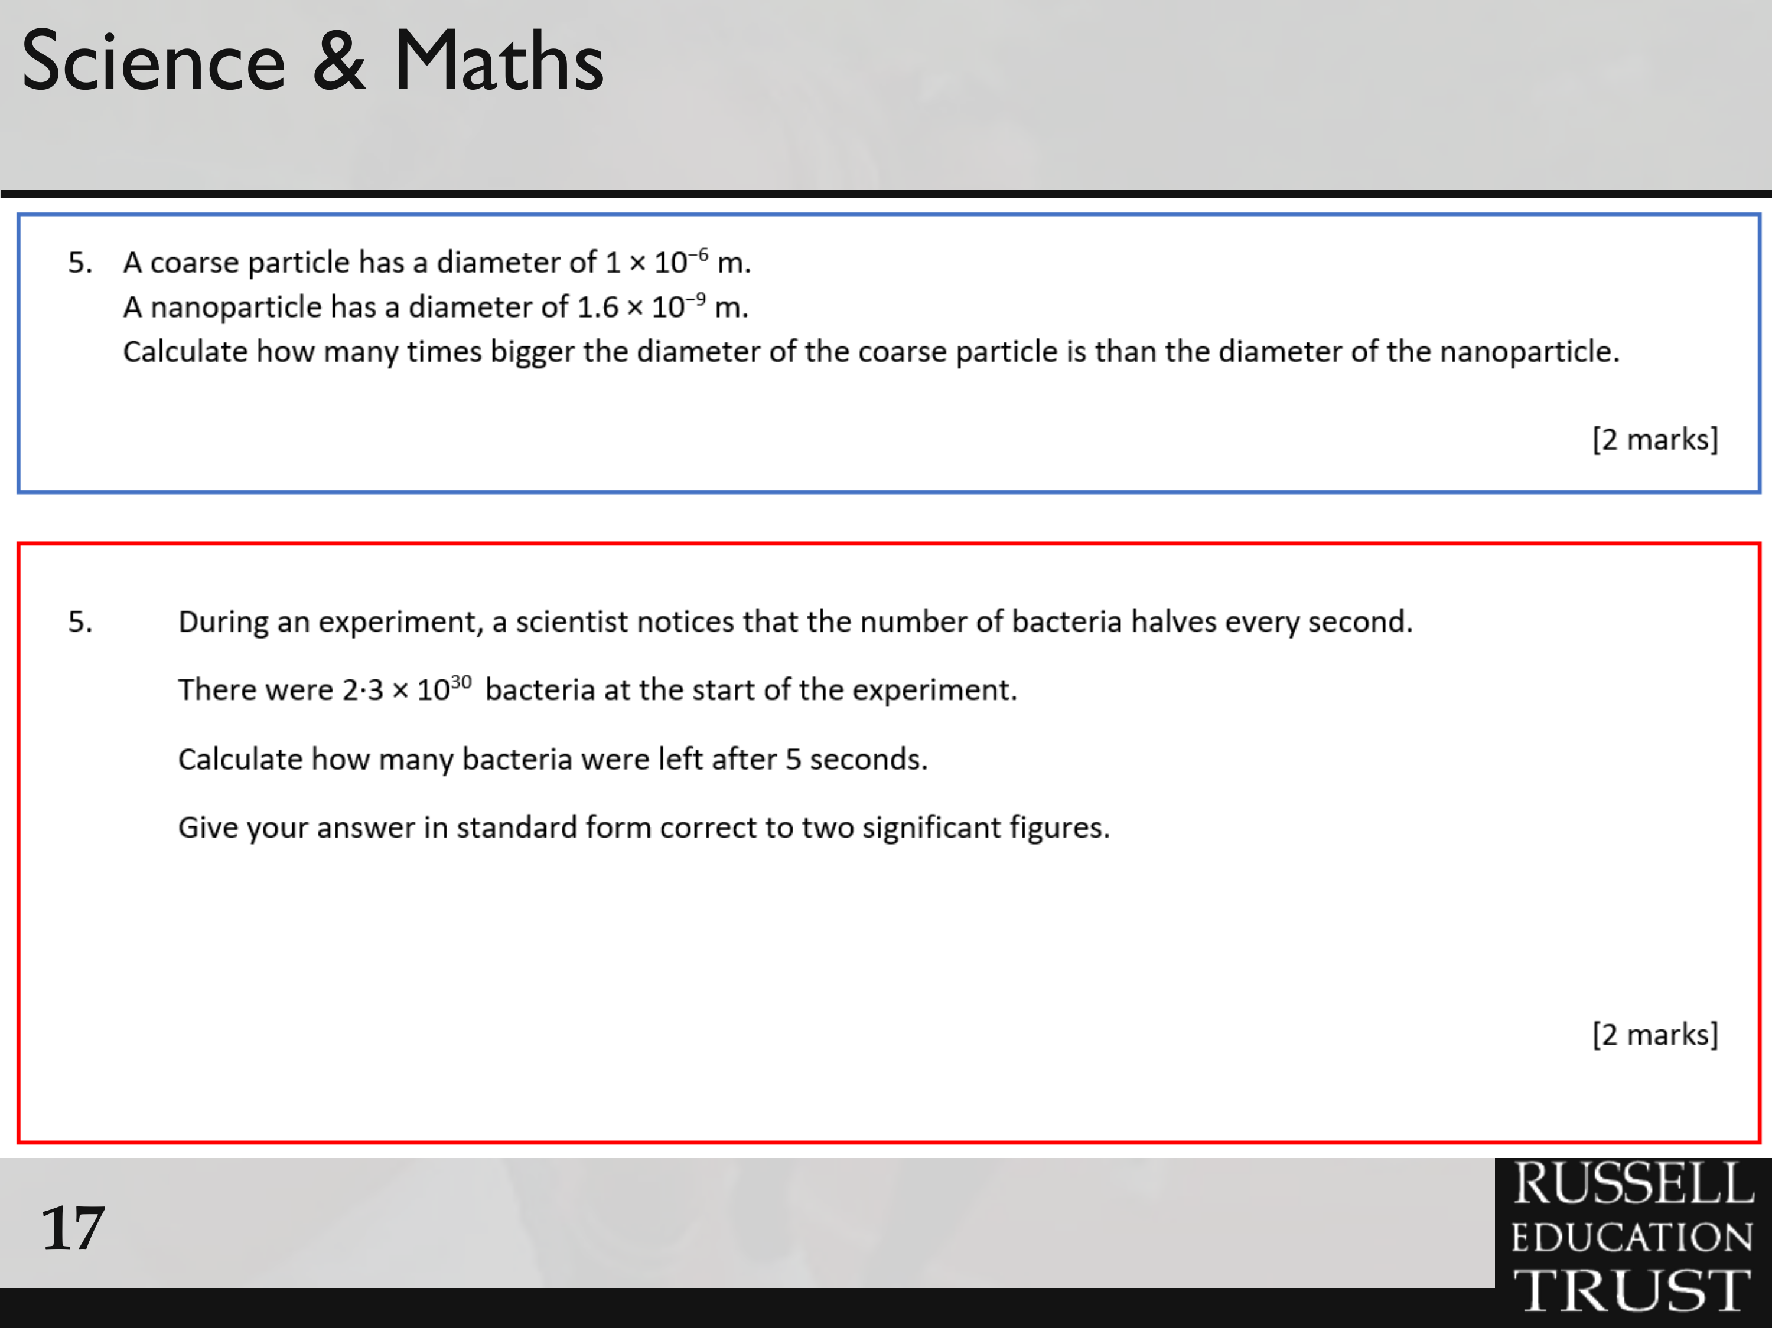

Slide 27
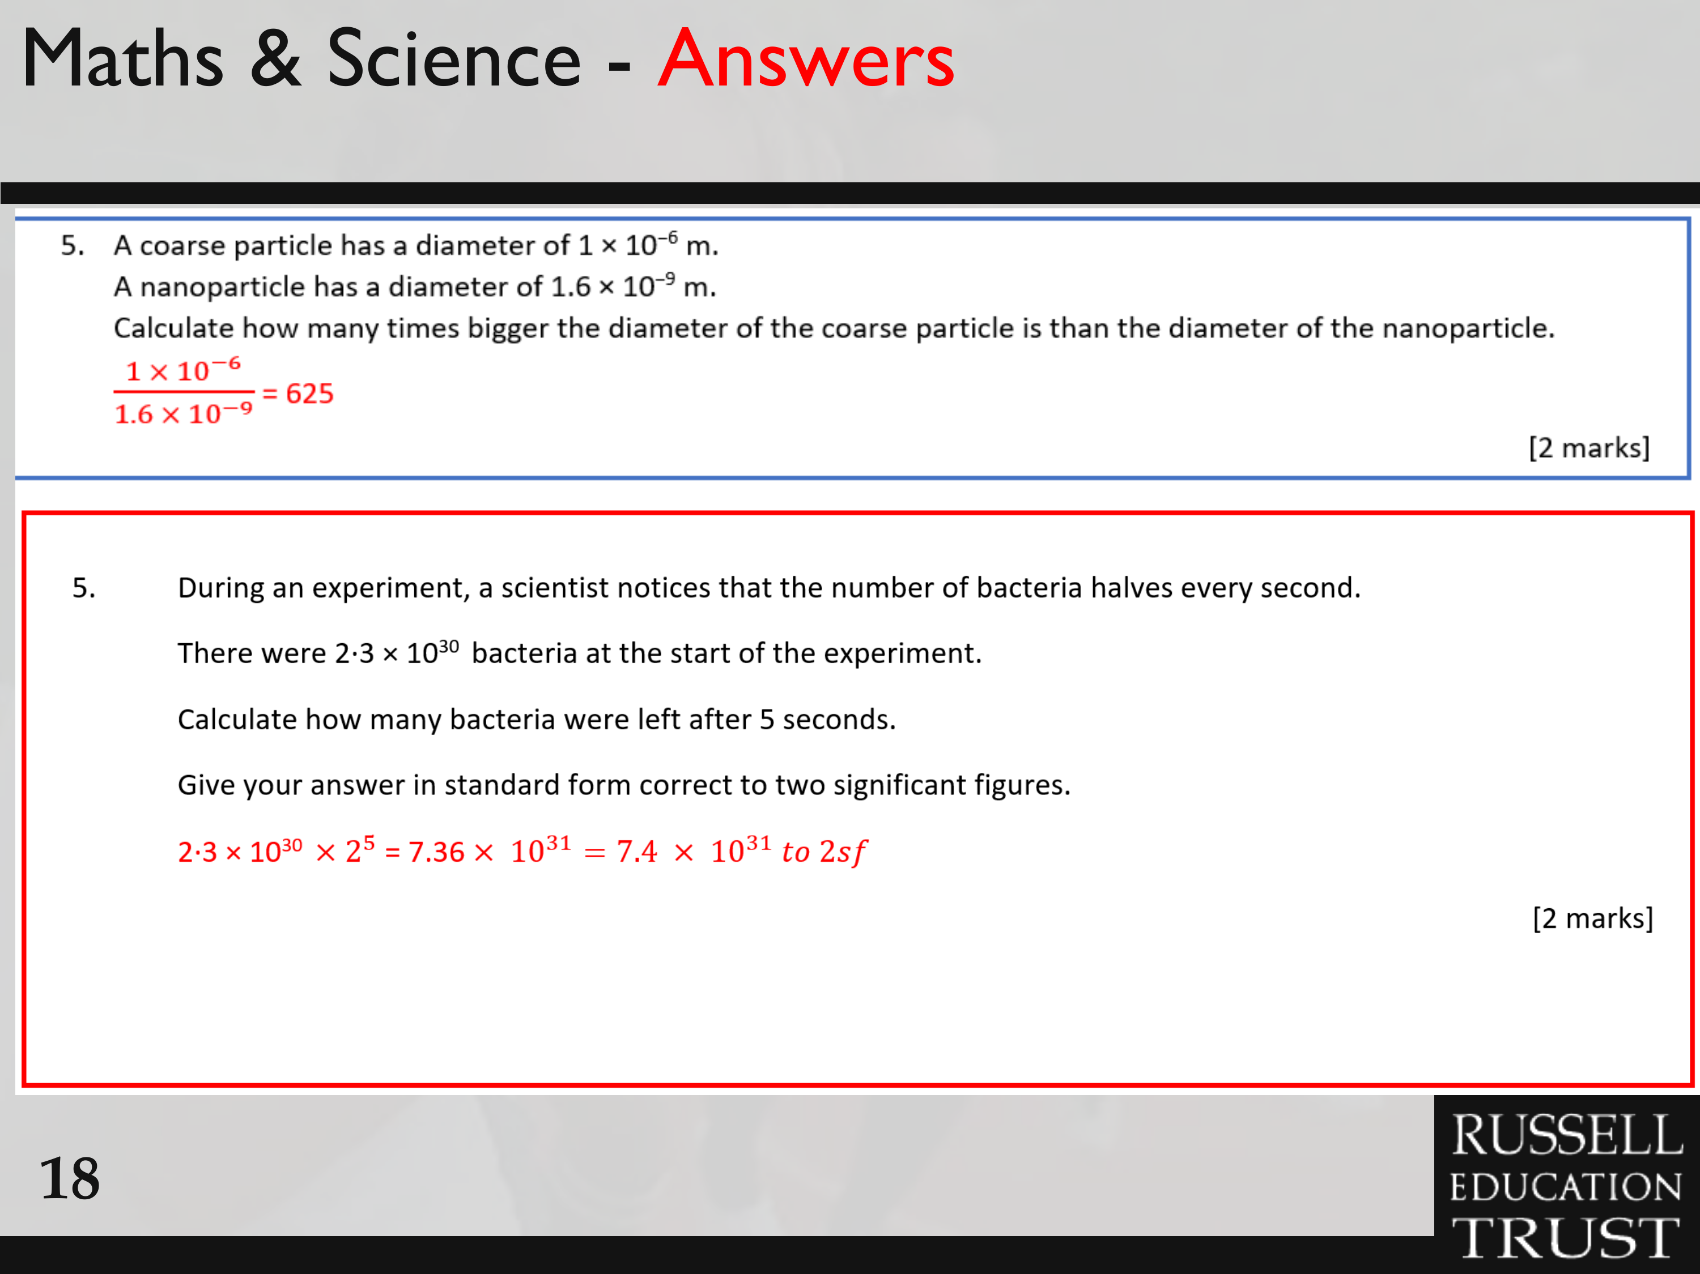

Slide 28
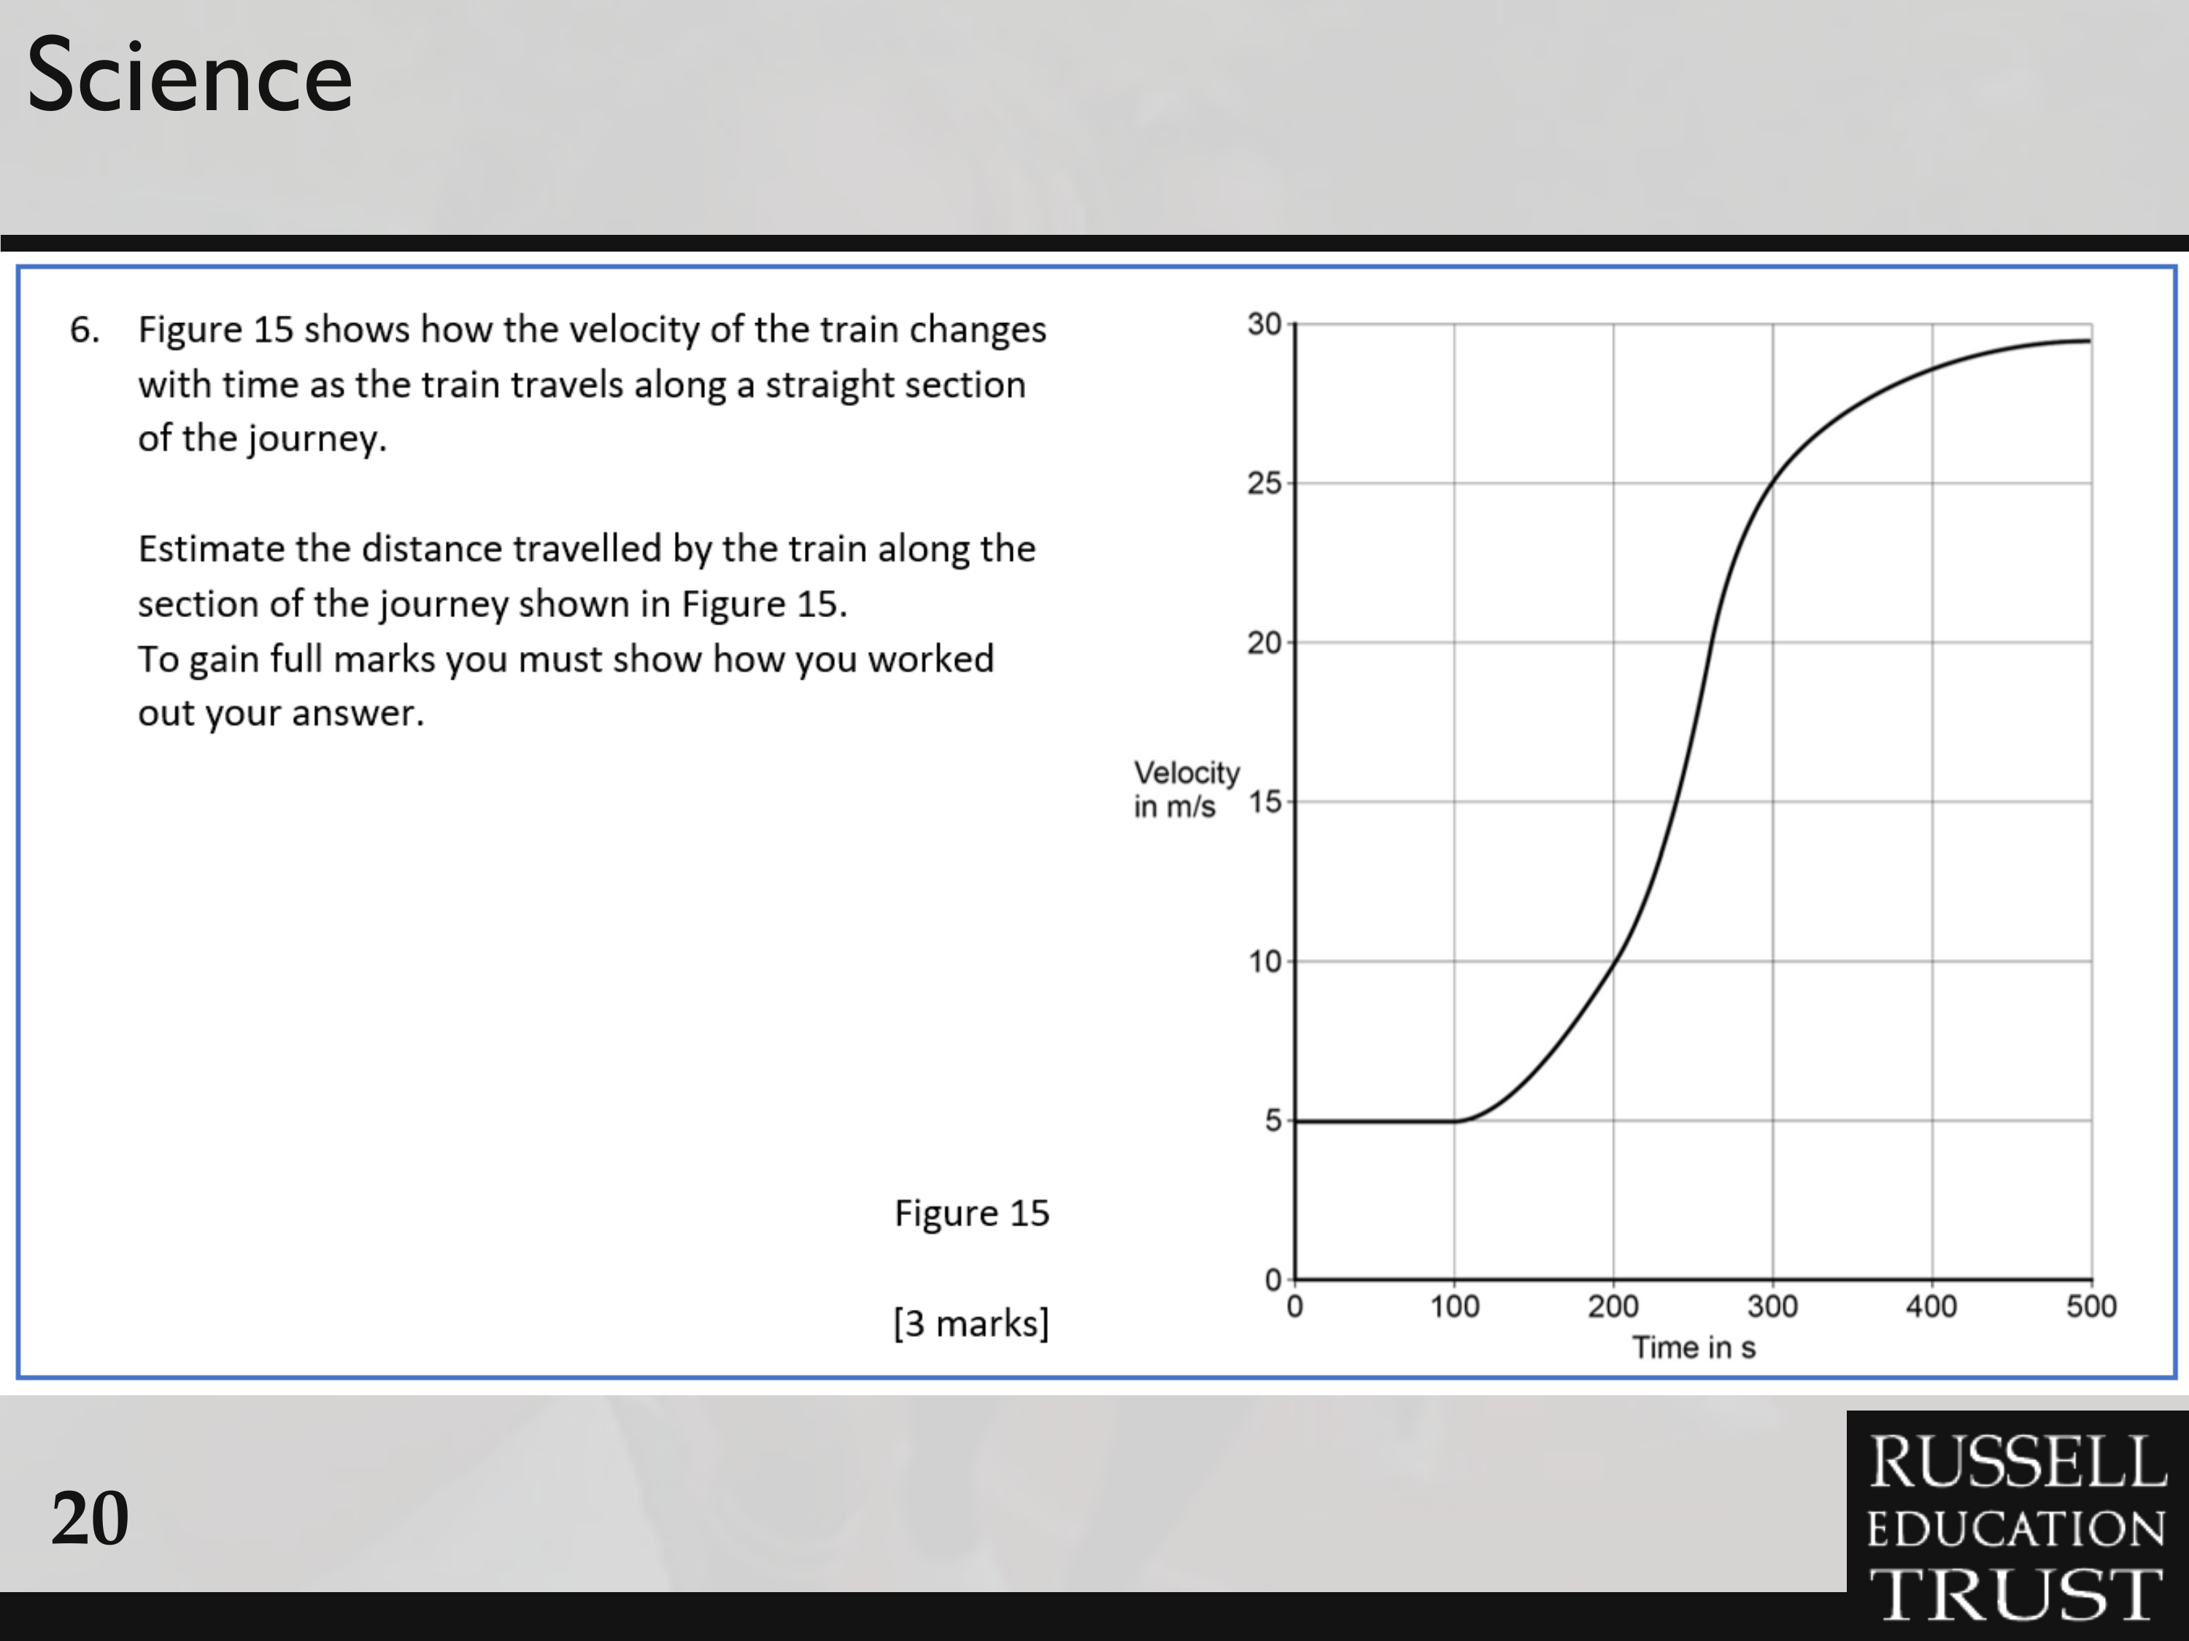

Slide 29
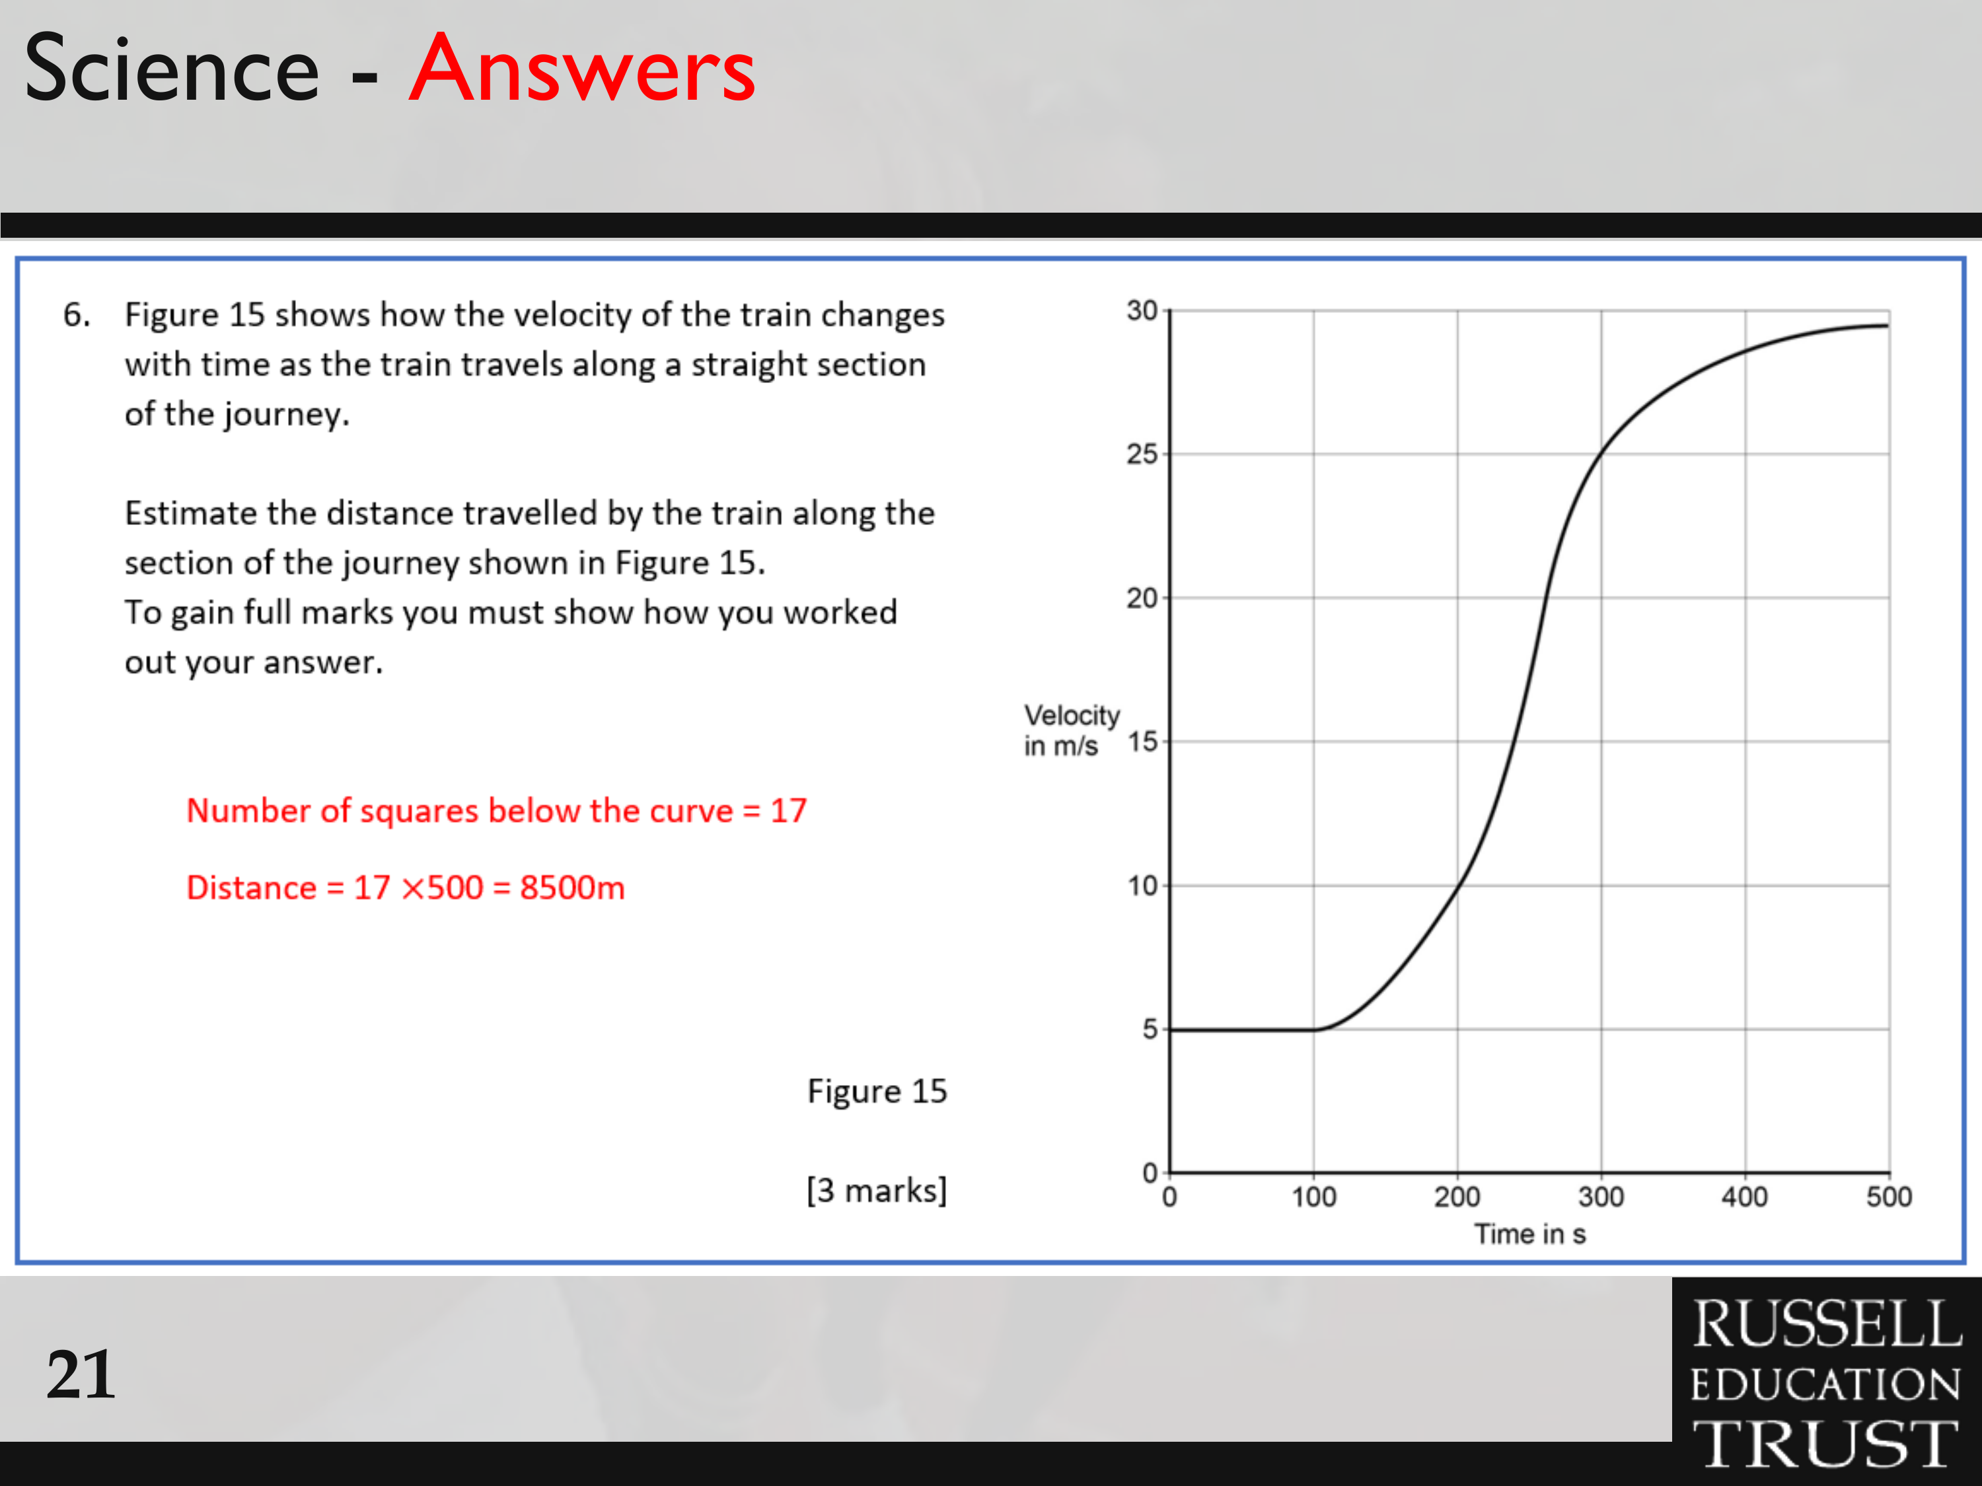

Slide 30
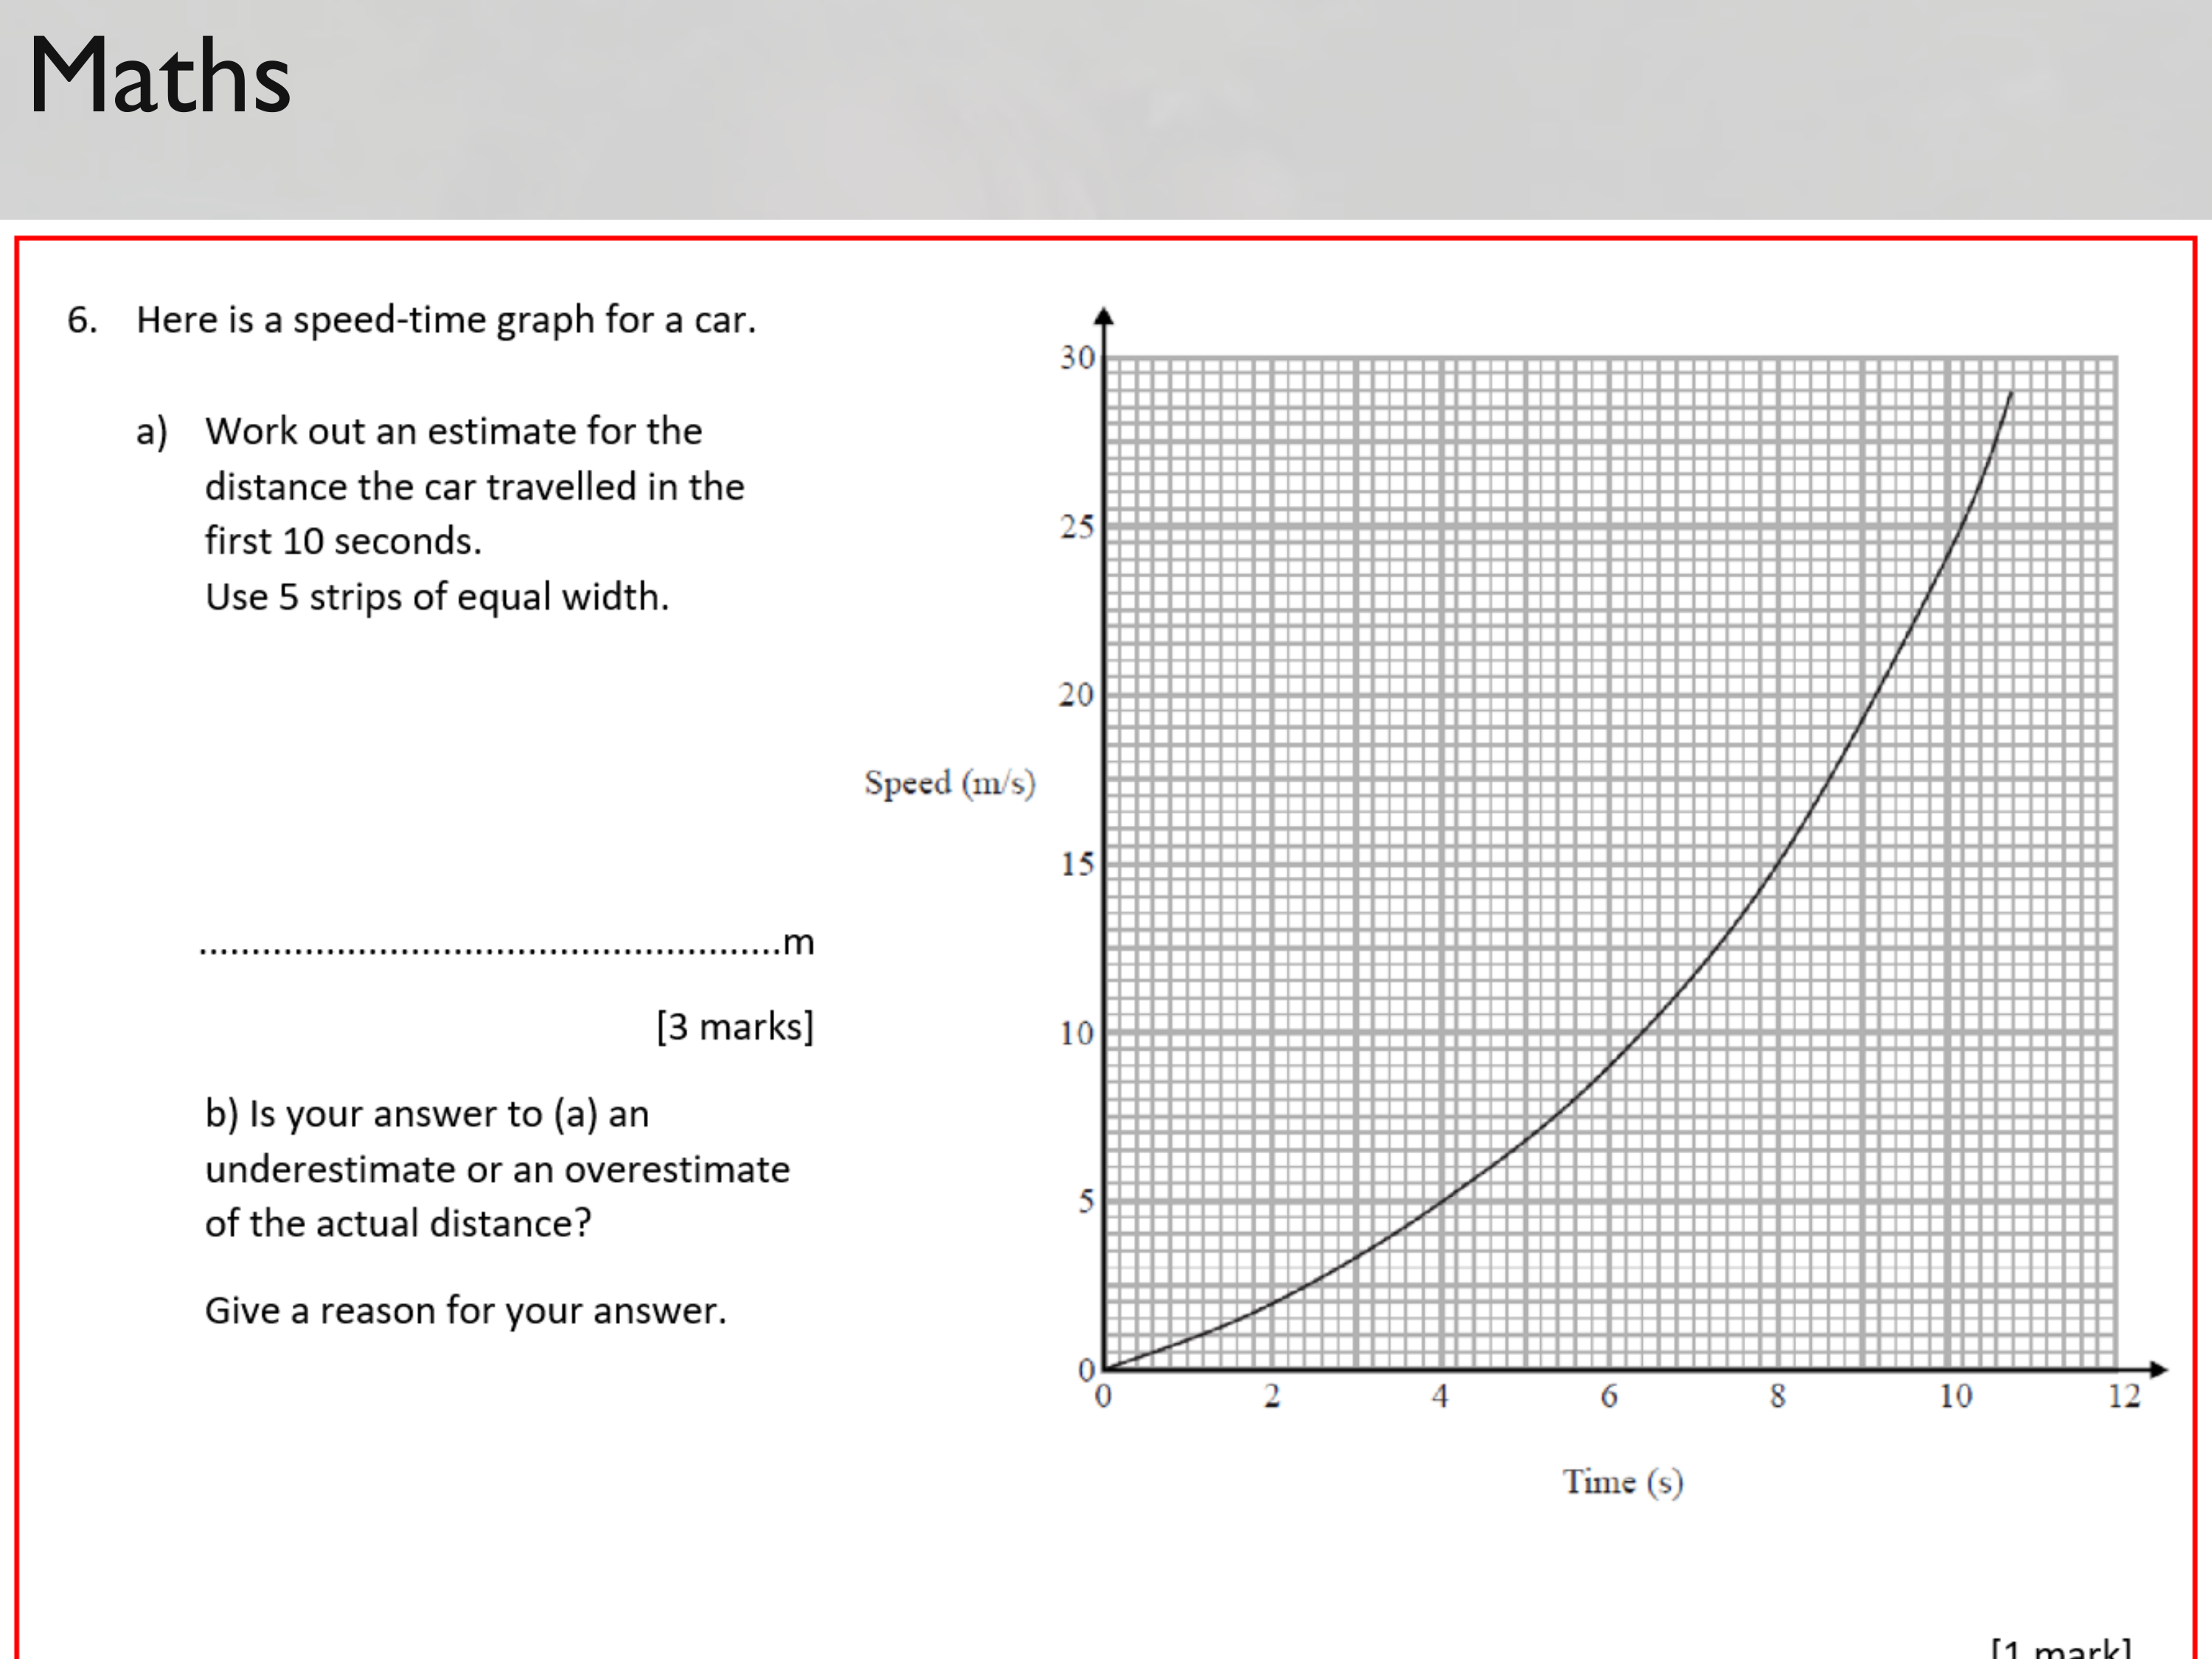

Slide 31
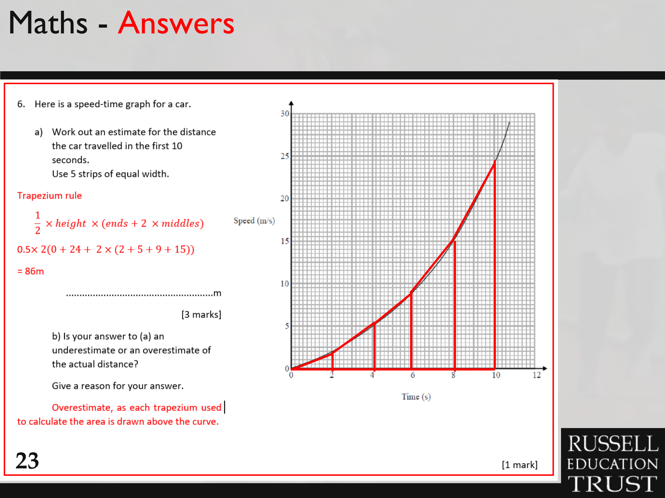

Slide 32
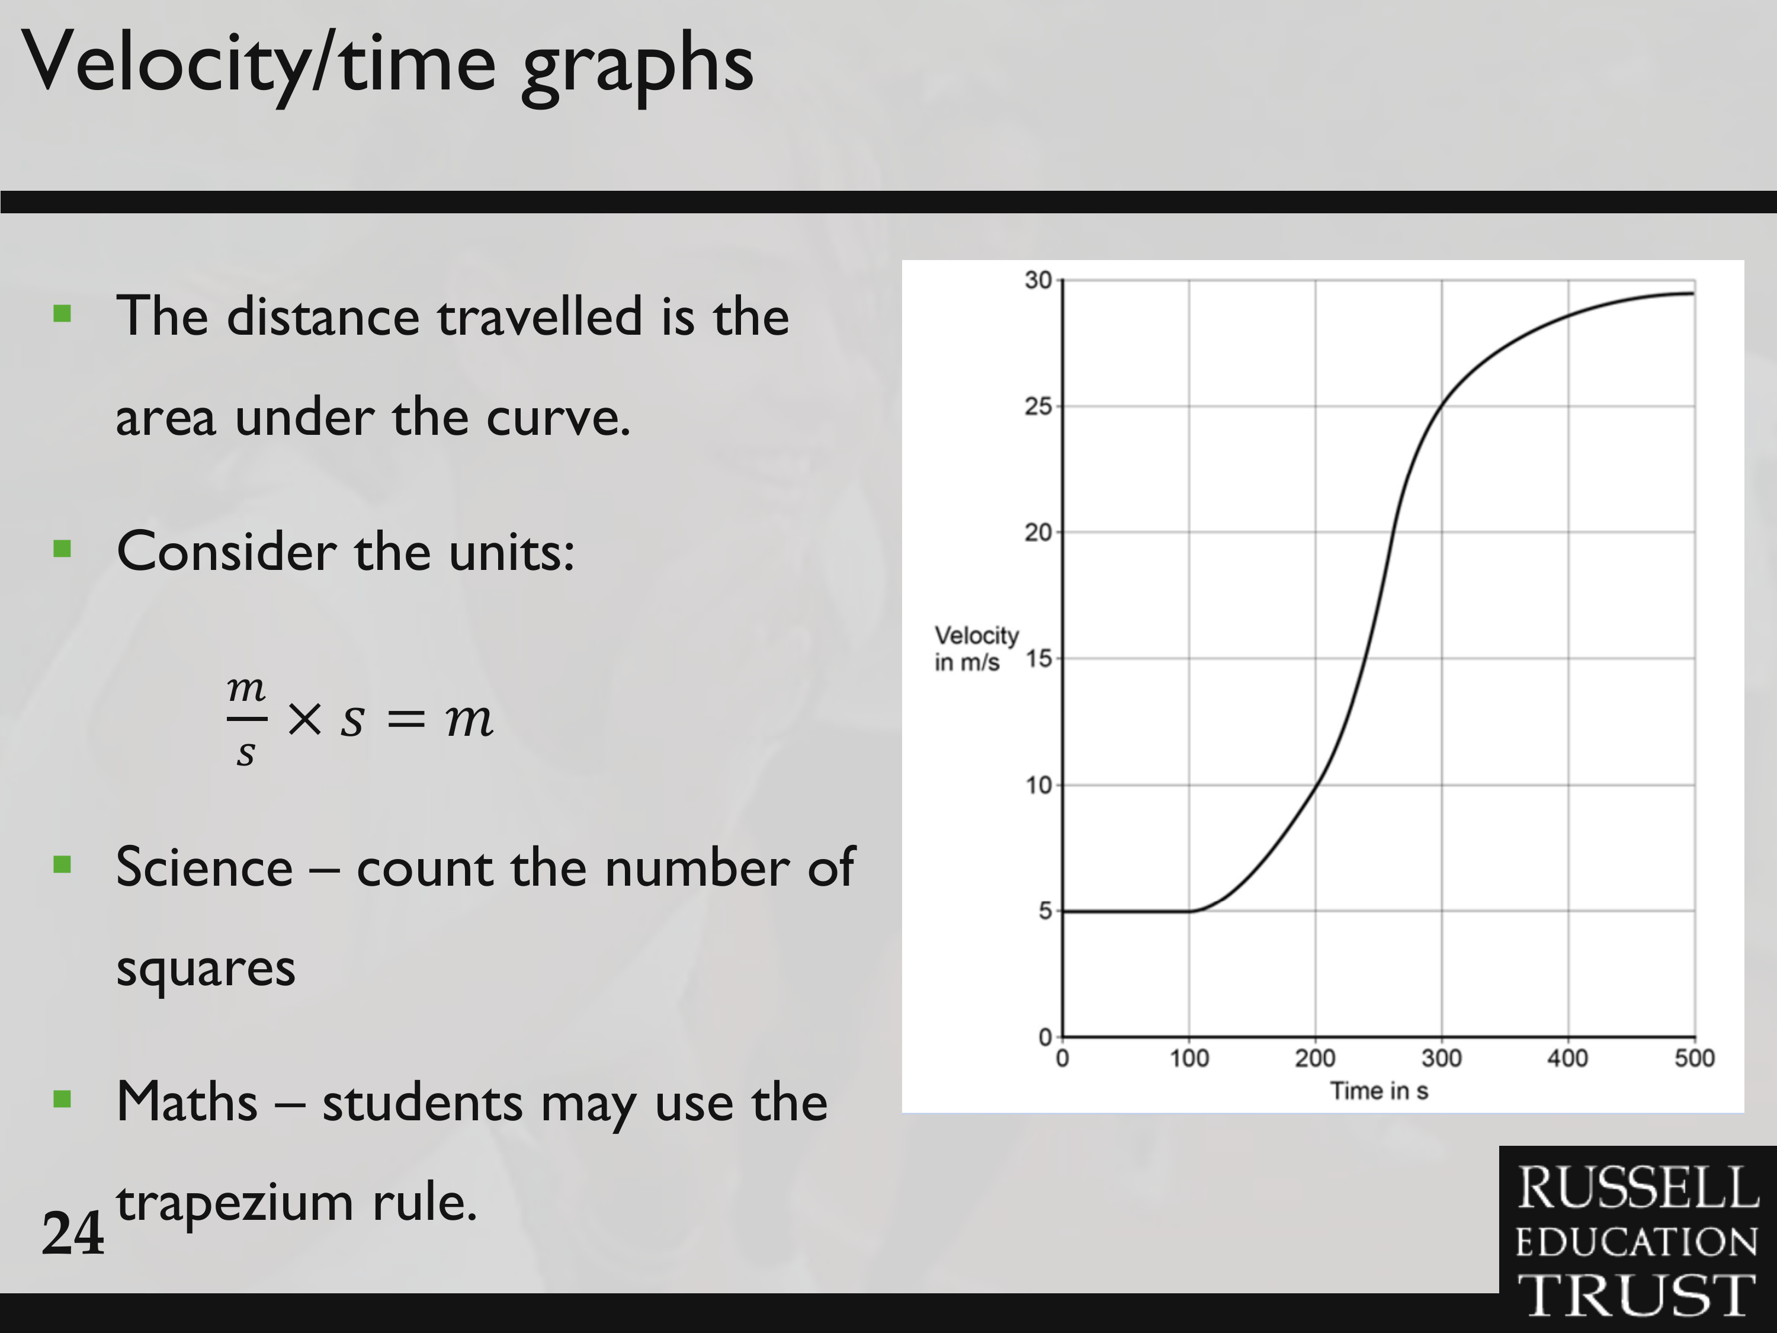

Slide 33
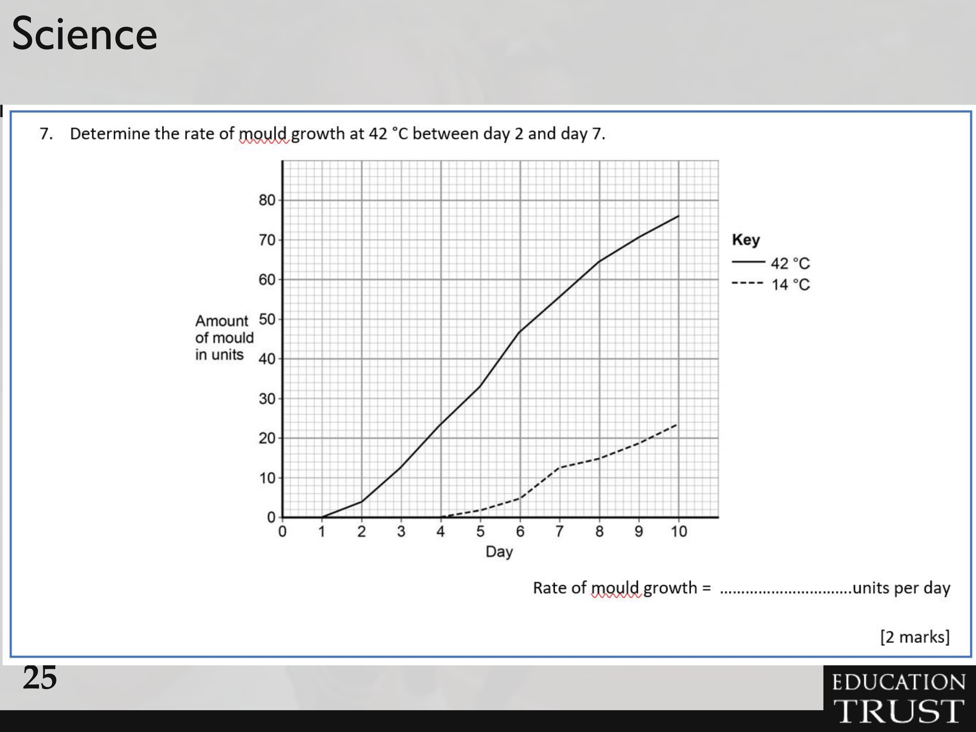

Slide 34
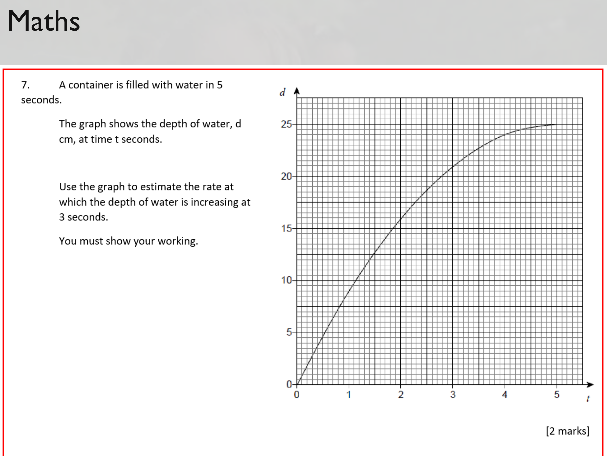

Slide 35
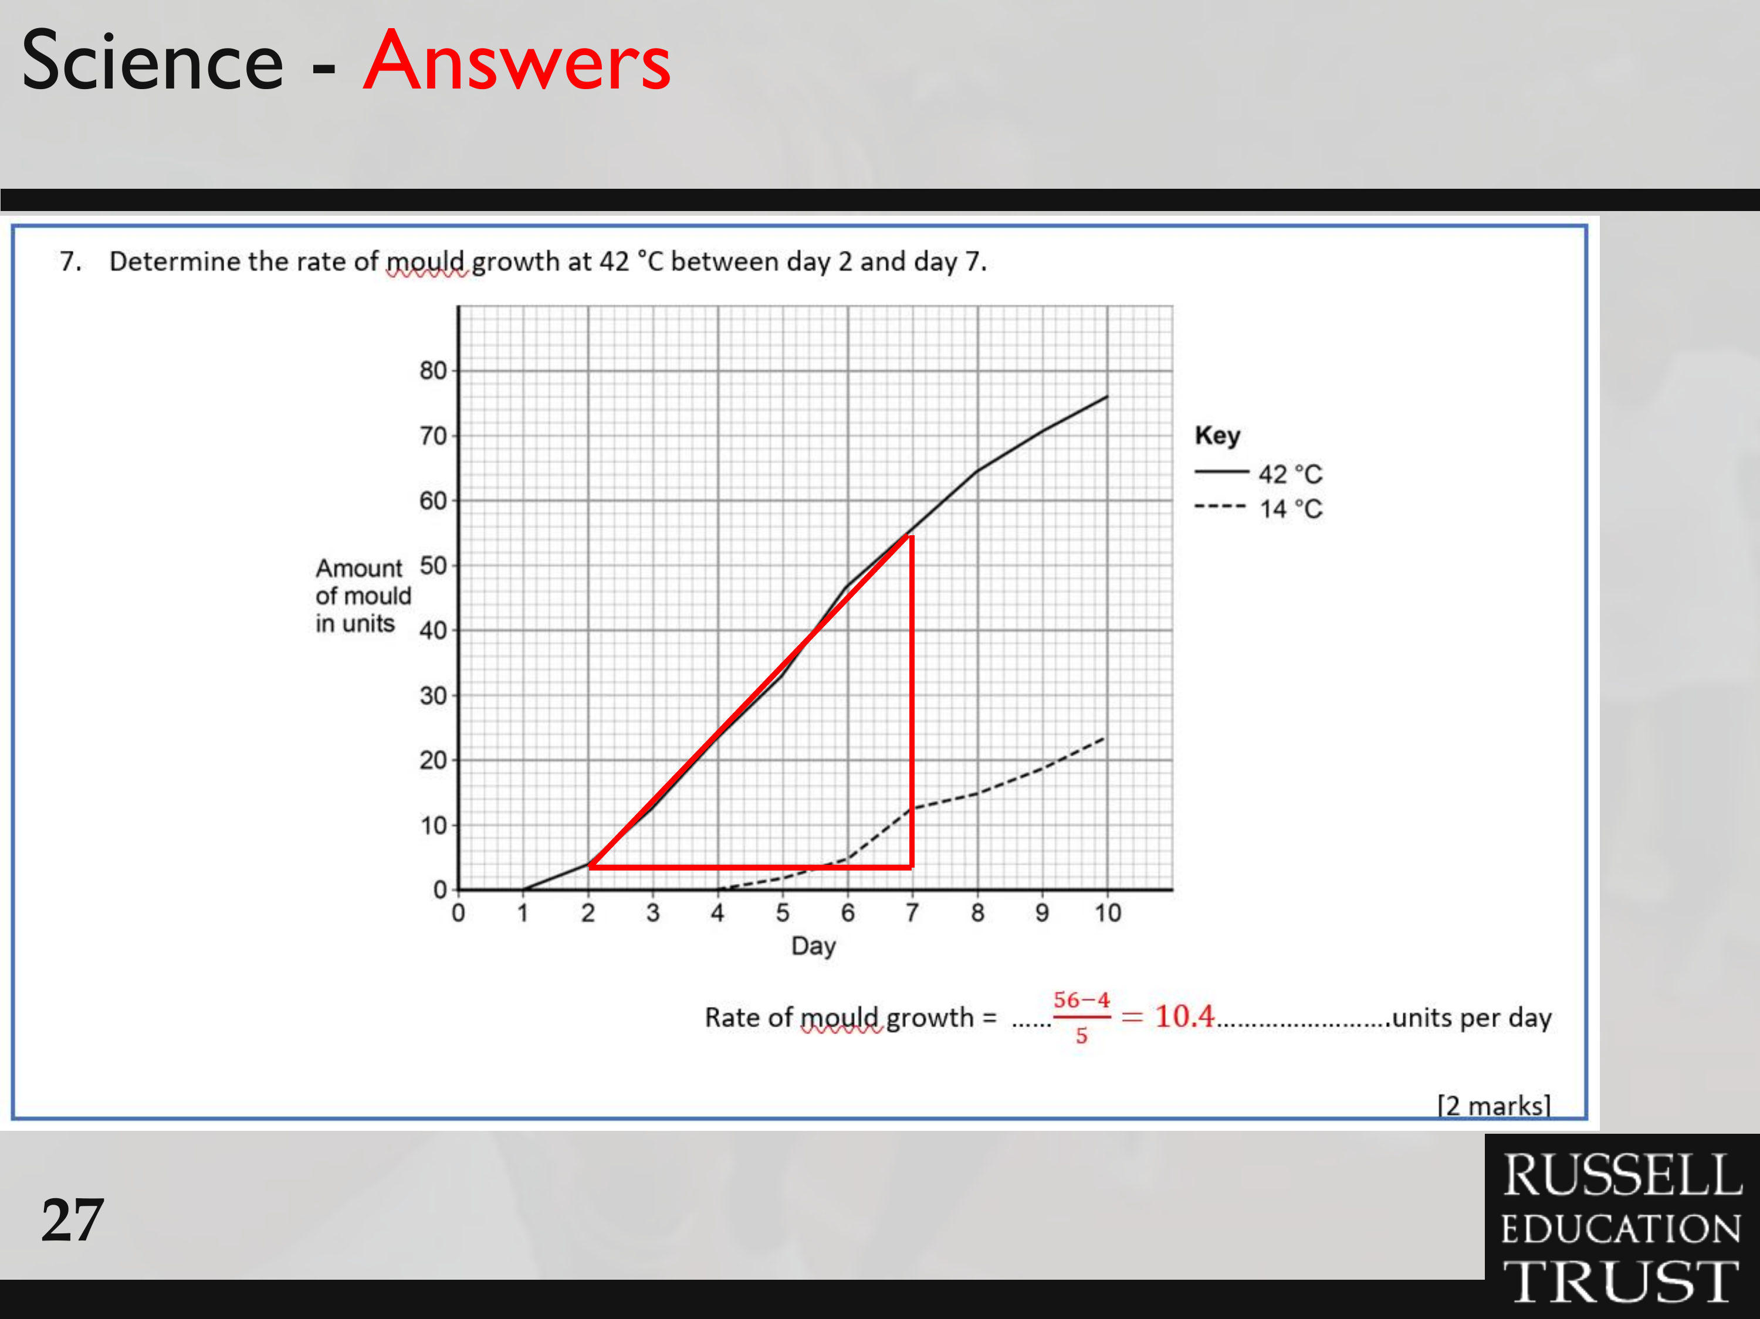

Slide 36
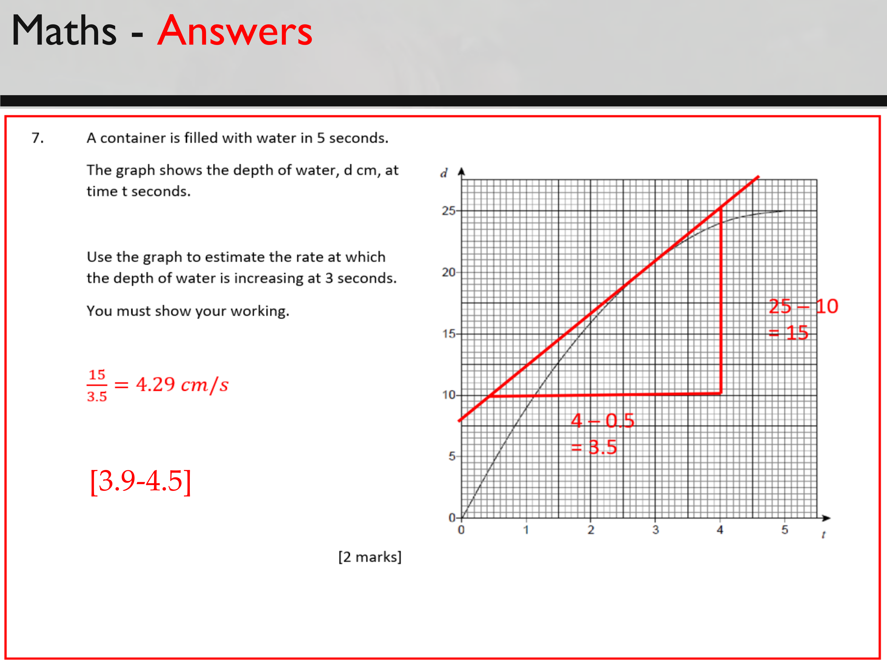

Slide 37
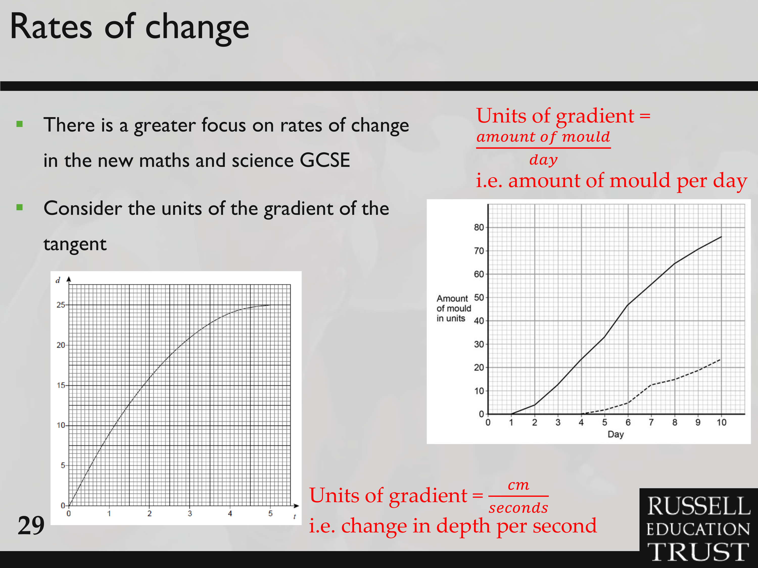

Slide 38

Sharing Resources

Slide 39
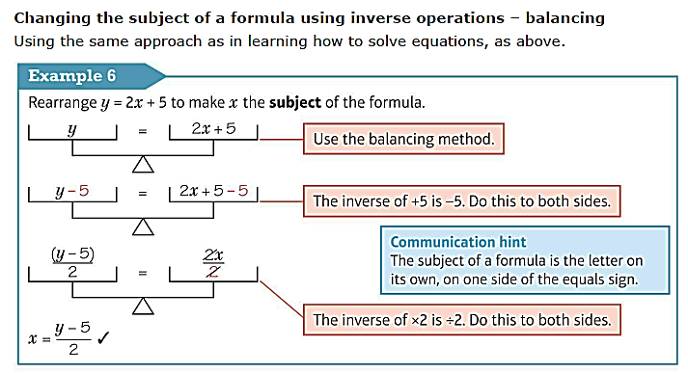
Changing the Subject

Slide 40
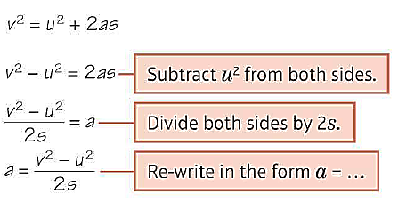
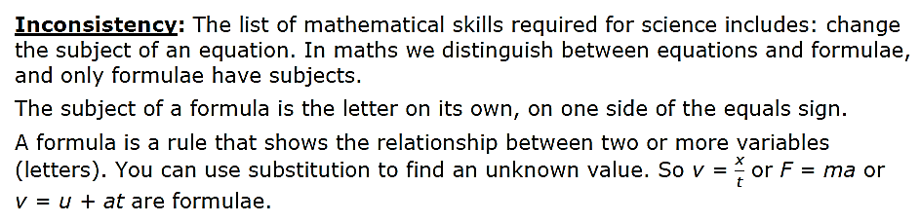
Changing the Subject
In maths we show them formulae triangles for speed and density formulae. But we use a more general approach to solving equations and rearranging formulae, using inverse operations.
Inconsistency: In maths, to solve equations and change the subject of a formula we use inverse operations and the idea of balancing equations by doing the same to both sides.
We do not say ‘cross multiply’ or ‘move through the equals and change the sign’, or similar explanations.

Slide 41
Further Reading
Deans for Impact (2015) The Science of Learning [Online] Accessible from: https://deansforimpact.org/resources/the-science-oflearning/ [retrieved 10 October 2018].
Education Endowment Foundation (2017) Improving Mathematics in Key Stages Two and Three Guidance Report. [Online] Accessible from: https://educationendowmentfoundation.org.uk/tools/guidance-reports/ [retrieved 10 October 2018].
Hodgen, J., Foster, C., Marks, R. & Brown, M. (2018) Improving Mathematics in Key Stages Two and Three: Evidence Review. [Online] Accessible from https://educationendowmentfoundation.org.uk/evidence-summaries/evidence-reviews/improvingmathematics-in-key-stages-two-and-three/ [retrieved 22 October 2018], 149-157.

Slide 42


Resources
https://tinyurl.com/yc5efvvs
Notes:
https://drive.google.com/drive/folders/1Ie2j6Z6jJh2-NBr0HRNnVu_Cc0By0htS?usp=sharing
https://tinyurl.com/yc5efvvs

Slide 43
Link to ITTECF Statements
CCF3: Learn that...
3.1. A school’s curriculum enables it to set out its vision for the knowledge, skills and values that its pupils will learn, encompassing the national curriculum within a coherent wider vision for successful learning.
3.2. Secure subject knowledge helps teachers to motivate pupils and teach effectively.
3.4. Anticipating common misconceptions within particular subjects is also an important aspect of curricular knowledge; working closely with colleagues to develop an understanding of likely misconceptions is valuable.
3.8. Pupils are likely to struggle to transfer what has been learnt in one discipline to a new or unfamiliar context.
CCF4: Learn that…
4.8. Practice is an integral part of effective teaching; ensuring pupils have repeated opportunities to practise, with appropriate guidance and support, increases success.
CCF6: Learn that...
Learn that ...
6.1. Effective assessment is critical to teaching because it provides teachers with information about pupils’ understanding and needs.
6.2. Good assessment (data) helps teachers avoid being over-influenced by potentially misleading factors…..

